Slide 1

The Role of Synthetic Data in Improving Supervised Learning Methods The Case of Land Use/Land Cover Classification
1
PhD Examination
João Pedro Martins Ribeiro da Fonseca
jpfonseca@novaims.unl.pt
Supervisor: Doctor Fernando José Ferreira Lucas Bação (bacao@novaims.unl.pt)
NOVA Information Management School
Doctoral Program in Information Management
October 12th, 2023

Slide 2
Agenda
1
About me
Introduction
Tabular and Latent Space Synthetic Data Generation: A Literature Review
Geometric SMOTE for Imbalanced Datasets with Nominal and Continuous Features
Improving Imbalanced Land Cover Classification with K-means SMOTE: Detecting and Oversampling Distinctive Minority Spectral Signatures
Increasing the Effectiveness of Active Learning: Introducing Artificial Data Generation in Active Learning for Land Use/Land Cover Classification
Improving Active Learning Performance Through the Use of Data Augmentation
Conclusions
PhD Examination – October 12th, 2023
João Fonseca

Slide 3

About me
1
Education:
Bsc in Economics @ NOVA SBE (2016)
Msc in Management @ NOVA SBE (2019)
Msc in Information Management @ NOVA IMS (2019)
Academic Positions:
Invited teaching assistant @ NOVA IMS (2019 – 2023)
Researcher @ NOVA IMS (2019 – 2020)
PhD Candidate @ NOVA IMS (2020 – 2023)
Research Intern @ NYU (early 2023)
Invited Assistant Professor @ NOVA IMS (Current)
Visiting Research Scholar @ NYU (Current)
Full bio: joaopfonseca.github.io
PhD Examination – October 12th, 2023
João Fonseca

Slide 4
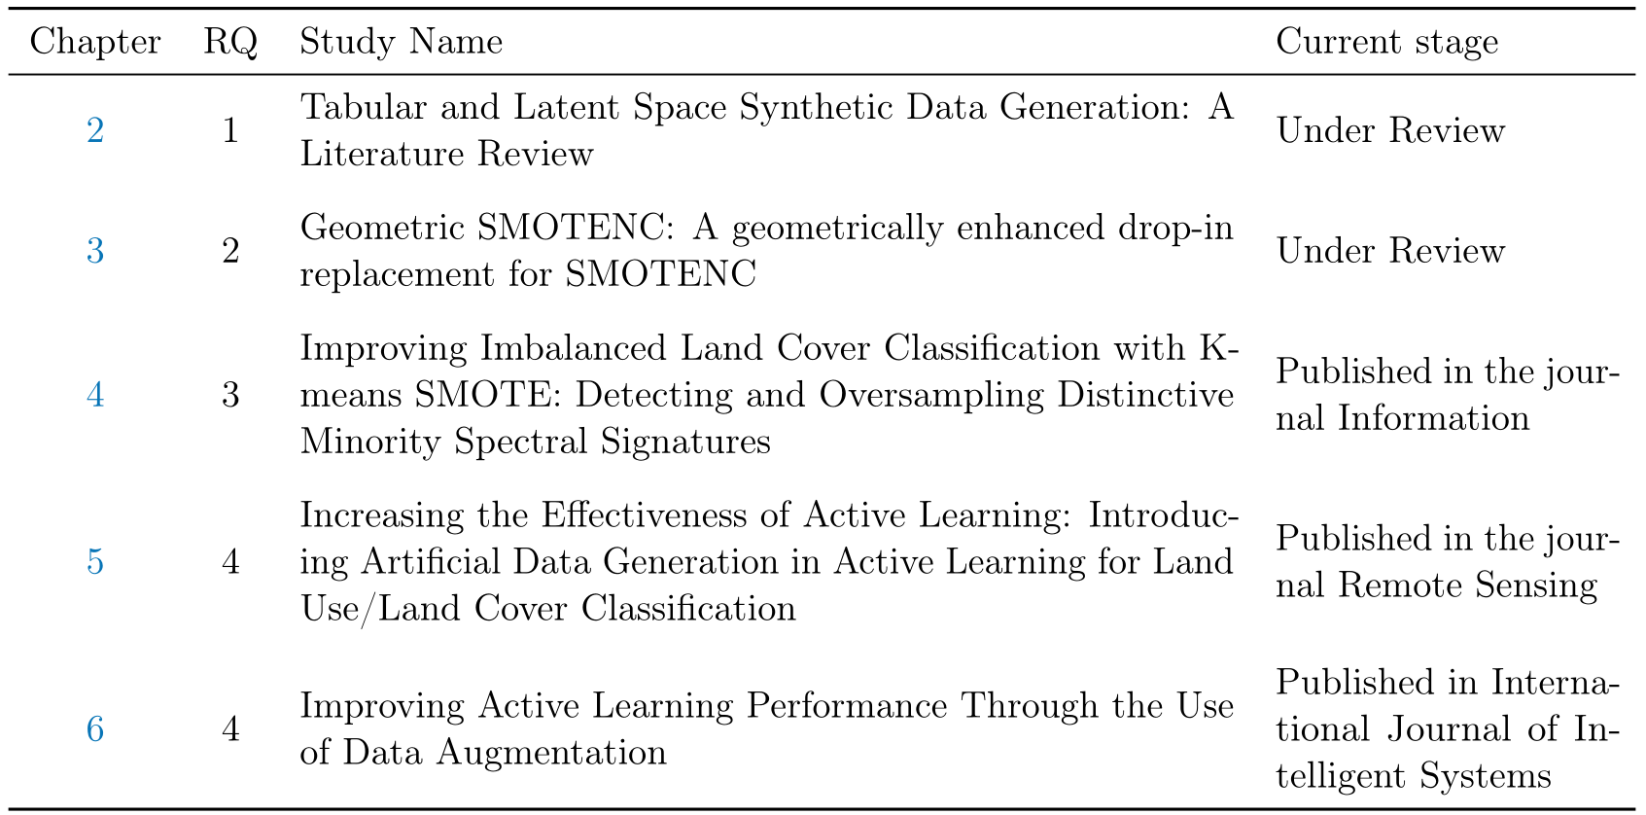
Publications based on doctoral work
1
Published in “Journal of Big Data”
Published in “Expert Systems with Applications”
PhD Examination – October 12th, 2023
João Fonseca

Slide 5
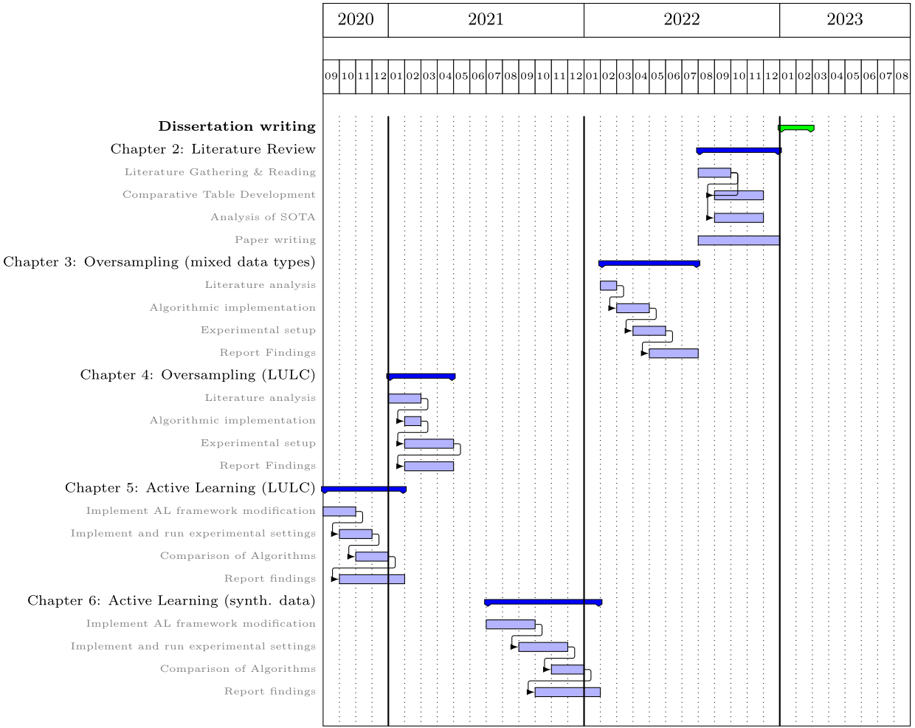
Introduction
1
This dissertation covers three main topics:
Synthetic Data Generation
Active Learning
Land Use/Land Cover Classification
PhD Examination – October 12th, 2023
João Fonseca
Notes:
Explain logic reasoning for the order of work + why it is useful + context

Slide 6

Introduction - Land Use/Land Cover Classification
1
LULC maps are essential for a variety of tasks
Production of LULC maps are costly and rarely updated
Automatic classification of LULC maps attempt to address this problem
But it is hindered by several limitations (e.g., Imbalanced training data, labeling errors and annotation cost)
Salinas Dataset
PhD Examination – October 12th, 2023
João Fonseca

Slide 7
Introduction - Active Learning
1
Collecting large volumes of training data becomes a challenge when its annotation is labor and time intensive
Active Learning (AL) reduces the cost for annotating training datasets
AL aims to find the most informative observations to annotate, maximizing the predictive power of a classifier, given a certain annotation budget.
AL faces two main challenges: Consistency and Efficiency
PhD Examination – October 12th, 2023
João Fonseca

Slide 8
Introduction - Synthetic Data Generation
1
Synthetic data is essential for several tasks:
Regularization (i.e., Data Augmentation)
Imbalanced learning (i.e., Oversampling)
Data anonymization
Semi-supervised learning
Self-supervised learning
Expands the training dataset by introducing synthetic observations, based on a prior data distribution
PhD Examination – October 12th, 2023
João Fonseca

Slide 9
Introduction – Research Questions
1
What are the main research lines in synthetic data generation?
Development of a literature review to study existing synthetic data generation methods and the core fields where they are being used.
How can one oversample data with both continuous and categorical features?
Development of an improved oversampling method to be used with mixed data types.
How can the quality and consistency of automatic LULC mapping be enhanced?
Exploration of imbalanced learning methods in the context of LULC.
How can efficient automated LULC mapping be achieved with limited availability of ground-truth data?
Development of an improved active learning framework in the remote sensing domain using artificial data generation.
PhD Examination – October 12th, 2023
João Fonseca

Slide 10
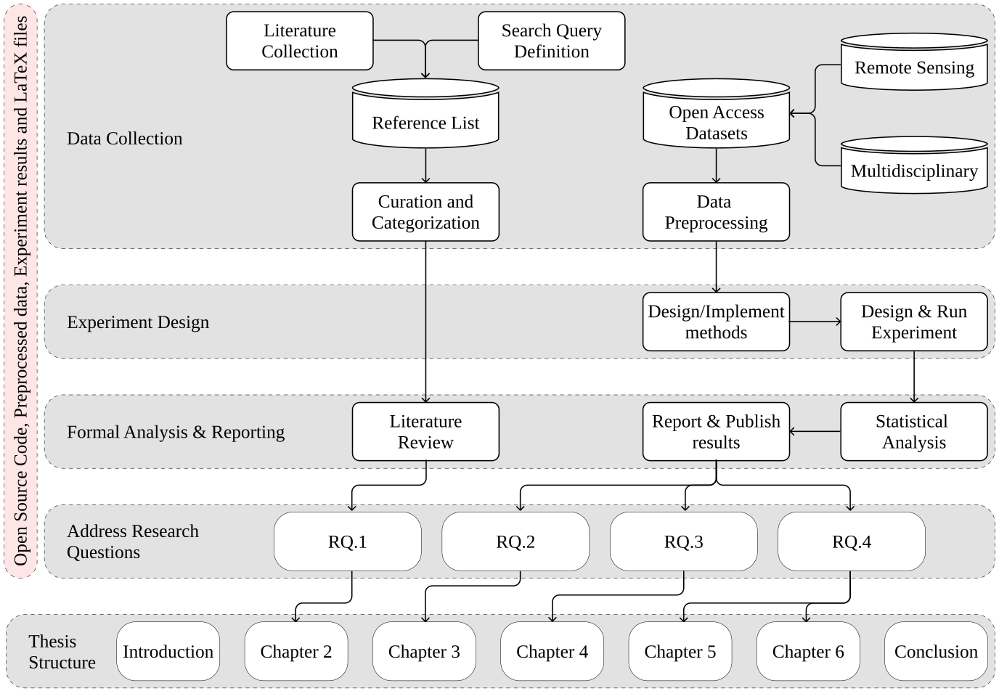
Introduction – State of Research
1
Key principles:
Common methodological approach across chapters
Use of publicly available data
Ensure reproducibility of every step in the process
Make every research output available to the community
Structure and methodological approach used in this dissertation.
PhD Examination – October 12th, 2023
João Fonseca

Slide 11
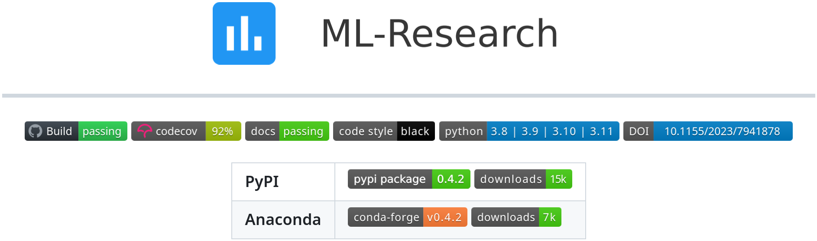
Introduction – State of Research
1
Key principles:
Common methodological approach across chapters
Use of publicly available data
Ensure reproducibility of every step in the process
Make every research output available to the community
Installable via “pip” and “conda”:
pip install ml-research
conda install -c conda-forge ml-research
PhD Examination – October 12th, 2023
João Fonseca

Slide 12
Introduction – Methodological approach
1
Data collection
Performance metrics
Experimental procedure
Ranking tables
Statistical analysis
Source (LULC datasets)
Universidad del País Vasco - Grupo de Inteligencia Computacional
http://www.ehu.eus/ccwintco
Source (Multidisciplinary)
UC Irvine Machine Learning Repository
https://archive.ics.uci.edu/
PhD Examination – October 12th, 2023
João Fonseca

Slide 13
Introduction – Methodological approach
1
Data collection
Performance metrics
Experimental procedure
Ranking tables
Statistical analysis
Standard performance metrics
Overall Accuracy
Geometric mean score (root of the product of class-wise sensitivity/recall)
F1-Score
Active Learning metrics
AULC – Area Under the Learning Curve
DUR – Data Utilization Rate
PhD Examination – October 12th, 2023
João Fonseca

Slide 14
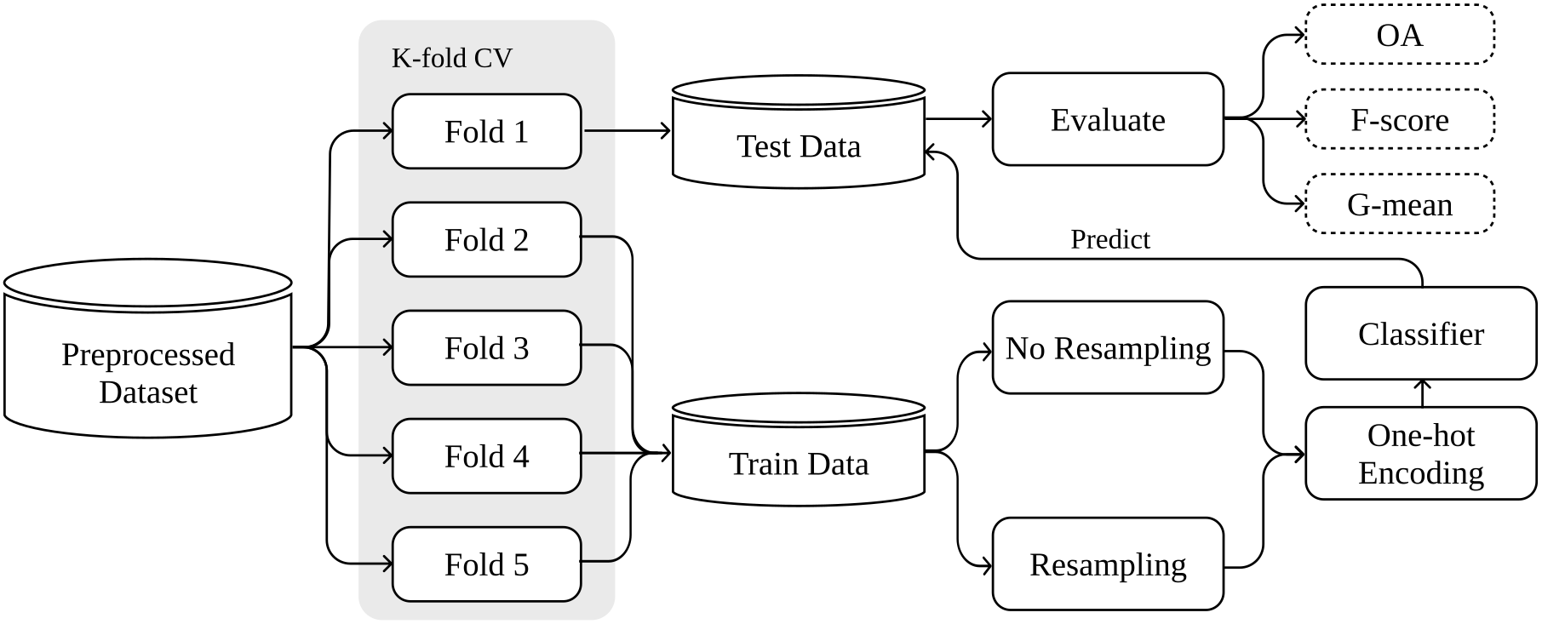
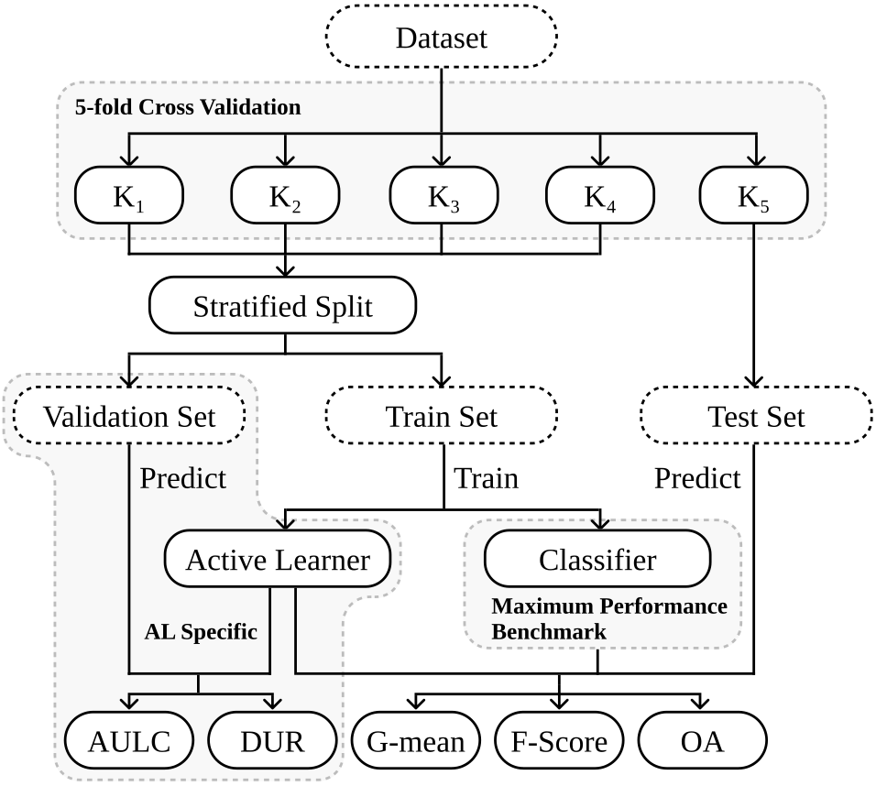
Introduction – Methodological approach
1
Data collection
Performance metrics
Experimental procedure
Ranking tables
Statistical analysis
PhD Examination – October 12th, 2023
João Fonseca

Slide 15
Introduction – Methodological approach
1
Data collection
Performance metrics
Experimental procedure
Ranking tables
Statistical analysis
Mean rankings will be used to aggregate results across multiple datasets
Fluctuations of performance scores between datasets make the analysis of mean scores less accurate.
The use of mean rankings are generally recommended in this scenario
PhD Examination – October 12th, 2023
João Fonseca

Slide 16
Introduction – Methodological approach
1
Data collection
Performance metrics
Experimental procedure
Ranking tables
Statistical analysis
Methods used must account for the multiple comparison problem
Two tests used:
Friedman test: Understand whether there is a difference across methods
Holm-Bonferroni or Wilcoxon signed-rank test
PhD Examination – October 12th, 2023
João Fonseca

Slide 17
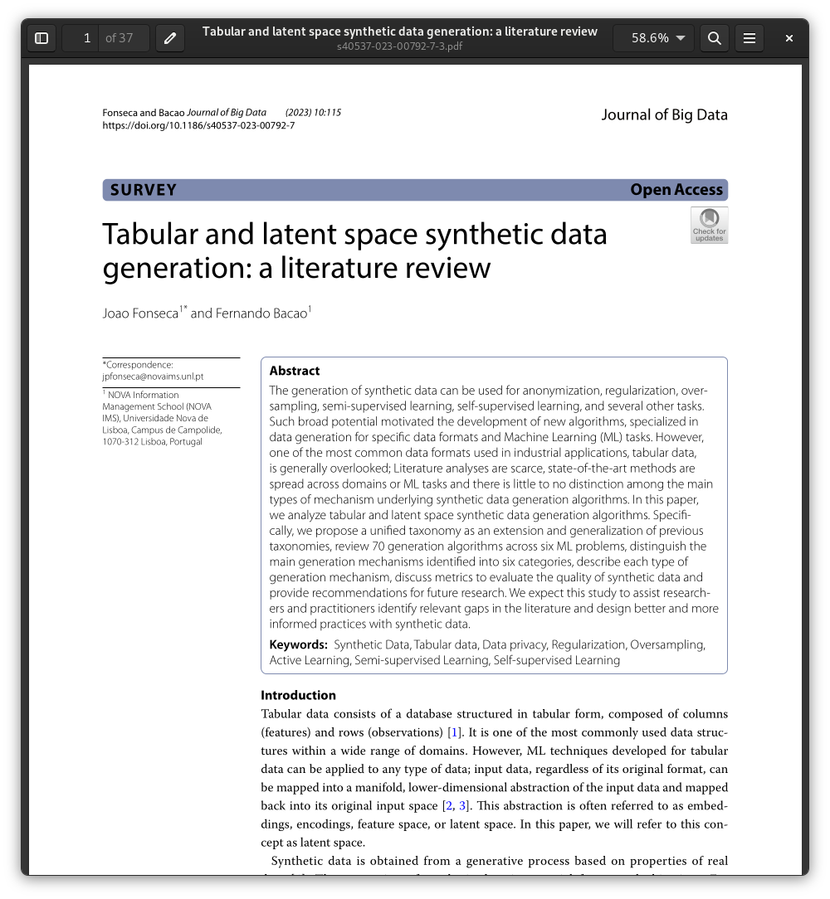
Tabular and Latent Space Synthetic Data Generation: A Literature Review
1
Published as:
Fonseca, J., & Bacao, F. (2023). Tabular and latent space synthetic data generation: a literature review. Journal of Big Data, 10(1), 115.
PhD Examination – October 12th, 2023
João Fonseca

Slide 18
Tabular and Latent Space Synthetic Data Generation: A Literature Review
1
The broad potential of SDG motivated the development of new algorithms, specialized in data generation for specific data formats and ML tasks.
However, one of the most common data formats used in industrial applications, tabular data, is generally overlooked.
In this paper, we analyze tabular and latent space synthetic data generation algorithms.
Propose a unified and extended taxonomy for SDG
Review 70 SDG algorithms across 6 ML tasks
Distinguish generation mechanisms into 6 categories
Review performance metrics to evaluate the quality of synthetic data
PhD Examination – October 12th, 2023
João Fonseca

Slide 19
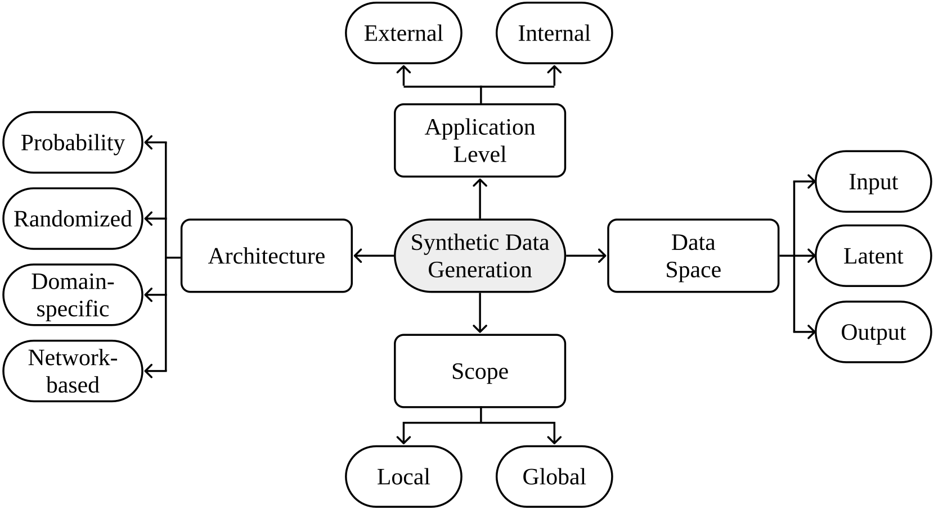
Tabular and Latent Space Synthetic Data Generation: A Literature Review
1
General taxonomy of data generation mechanisms proposed in this paper.
PhD Examination – October 12th, 2023
João Fonseca

Slide 20
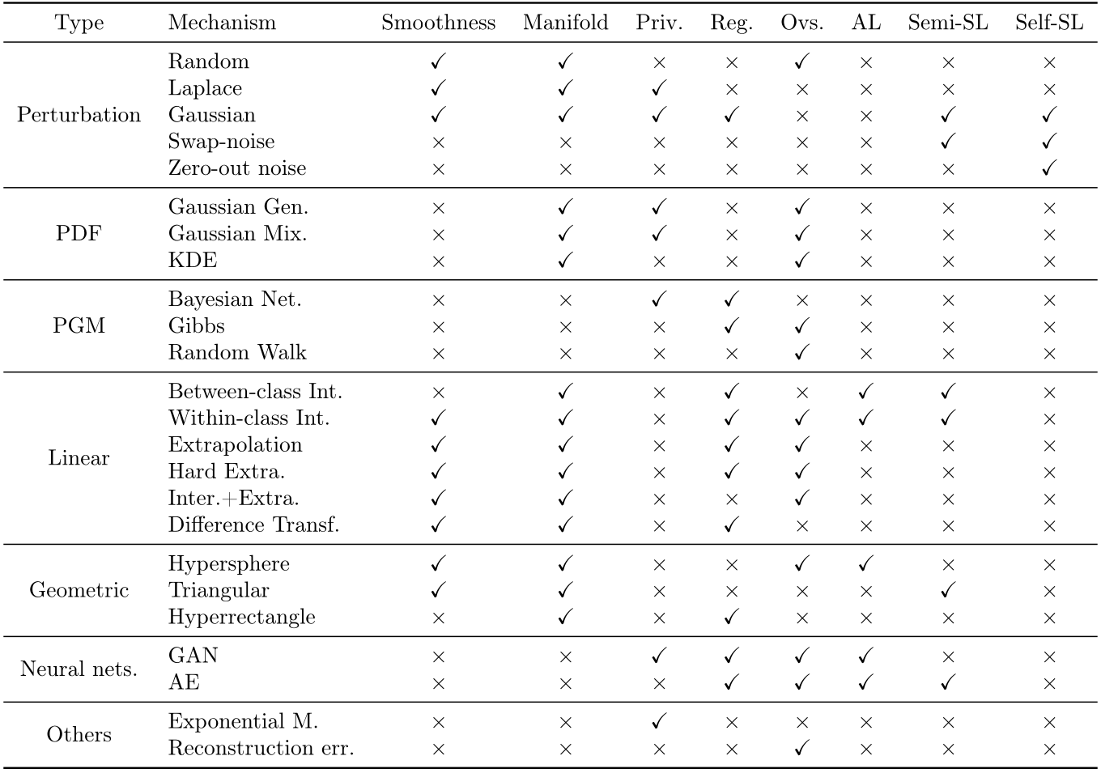
Tabular and Latent Space Synthetic Data Generation: A Literature Review
1
Analysis of synthetic data generation mechanisms.
PhD Examination – October 12th, 2023
João Fonseca
Notes:
The smoothness condition requires that if two observations xi , xj are close, then it’s expected that yi , yj have the same value. The manifold condition requires synthetic data generation to occur within local Euclidean topological spaces.

Slide 21
Tabular and Latent Space Synthetic Data Generation: A Literature Review
1
Conclusions:
There are several approaches to generate synthetic data across a wide range of tasks
However, there are several limitations in the literature regarding:
Latent space learning
Selection of generation mechanisms
Data privacy mechanisms
Analysis of quality of synthetic data for regularization techniques
Consistency and interpretability of generative neural network methods
Ensemble techniques for tabular data
Oversampling tabular data with mixed data types
Lack of research of synthetic data generation in tabular few-shot learning
Lack of research of the effect of synthetic data towards model fairness and bias.
PhD Examination – October 12th, 2023
João Fonseca

Slide 22
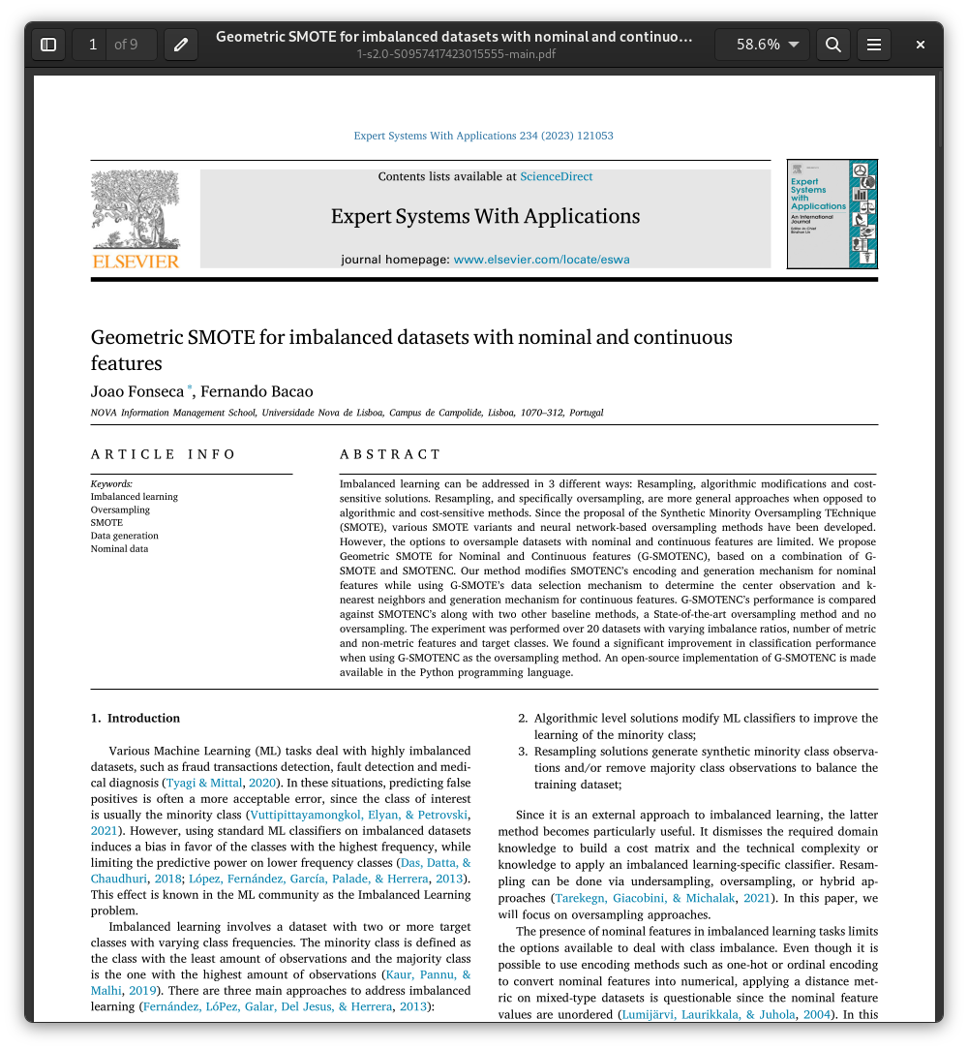
Geometric SMOTE for Imbalanced Datasets with Nominal and Continuous Features
1
Published as:
Fonseca, J., & Bacao, F. (2023). Geometric SMOTE for imbalanced datasets with nominal and continuous features. Expert Systems with Applications, 234, 121053.
PhD Examination – October 12th, 2023
João Fonseca

Slide 23
Geometric SMOTE for Imbalanced Datasets with Nominal and Continuous Features
1
Since the proposal of the Synthetic Minority Oversampling TEchnique (SMOTE), various SMOTE variants and neural network-based oversampling methods have been developed.
However, the options to oversample datasets with nominal and continuous features are limited.
We propose Geometric SMOTE for Nominal and Continuous features (G-SMOTENC)
Our method modifies SMOTENC’s encoding and generation mechanism for nominal features while using G-SMOTE’s data selection mechanism
PhD Examination – October 12th, 2023
João Fonseca

Slide 24
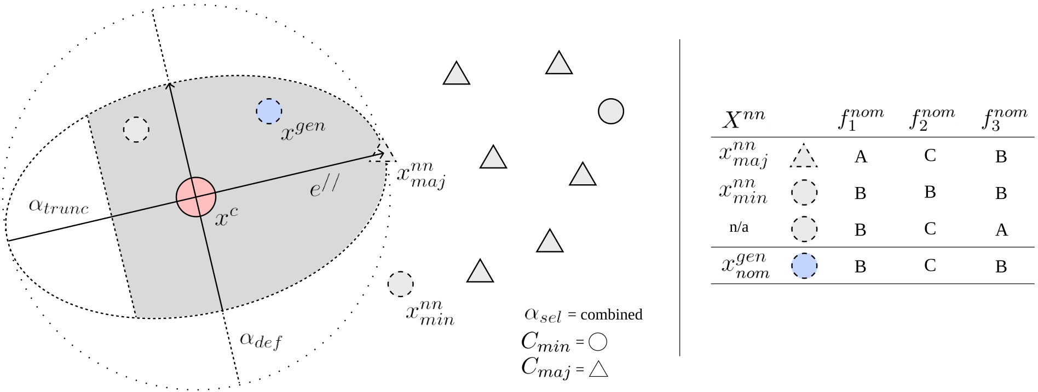
Geometric SMOTE for Imbalanced Datasets with Nominal and Continuous Features
1
Visual depiction of G-SMOTENC
PhD Examination – October 12th, 2023
João Fonseca

Slide 25
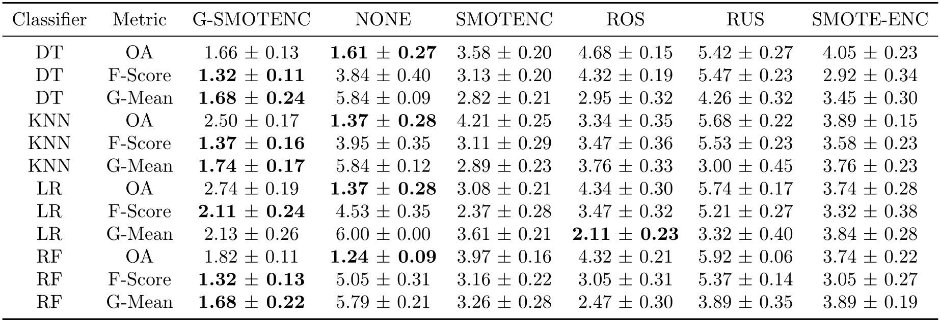
Geometric SMOTE for Imbalanced Datasets with Nominal and Continuous Features
1
Mean rankings over the different datasets (20), folds (5) and runs (3) used in the experiment.
PhD Examination – October 12th, 2023
João Fonseca

Slide 26
Geometric SMOTE for Imbalanced Datasets with Nominal and Continuous Features
1
Conclusions:
The proposed method can be considered a generalization of the classical SMOTENC approach, since a specific parametrization of this algorithm will replicate SMOTENC’s behavior
The proposed method allows a significantly wider array of possibilities and higher variability in the synthetic data being generated.
Can be applied before any type of categorical feature encoding.
The proposed method consistently outperformed the remaining oversamplers, including SMOTENC and SMOTE-ENC
PhD Examination – October 12th, 2023
João Fonseca

Slide 27
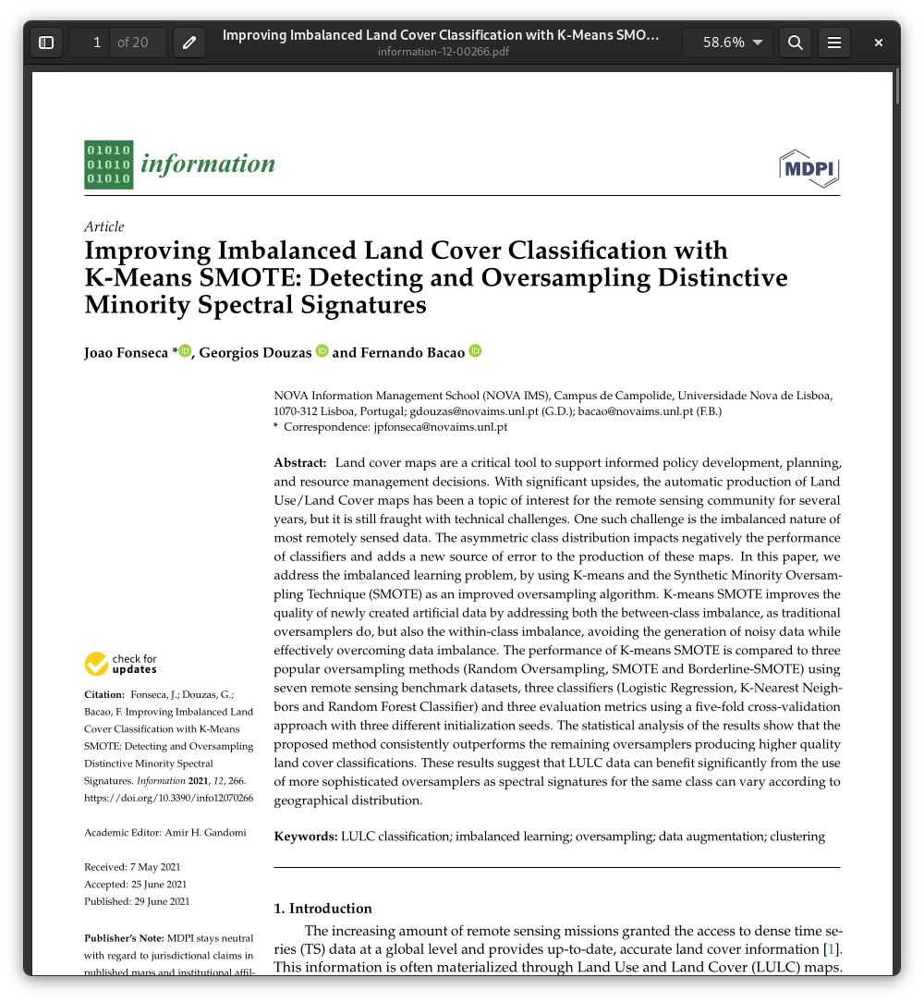
Improving Imbalanced Land Cover Classification with K-means SMOTE: Detecting and Oversampling Distinctive Minority Spectral Signatures
1
Published as:
Fonseca, J., Douzas, G., Bacao, F. (2021). Improving Imbalanced Land Cover Classification with K-Means SMOTE: Detecting and Oversampling Distinctive Minority Spectral Signatures. Information, 12(7), 266.
PhD Examination – October 12th, 2023
João Fonseca

Slide 28
Improving Imbalanced Land Cover Classification with K-means SMOTE: Detecting and Oversampling Distinctive Minority Spectral Signatures
1
Land cover maps are a critical tool to support informed policy development, planning, and resource management decisions
However, the automatic production of Land Use/Land Cover maps is fraught with several limitations
One such challenge is the imbalanced nature of most remotely sensed data
We address the imbalanced learning problem, by using K-means and the Synthetic Minority Oversampling TEchnique (K-means SMOTE)
PhD Examination – October 12th, 2023
João Fonseca

Slide 29
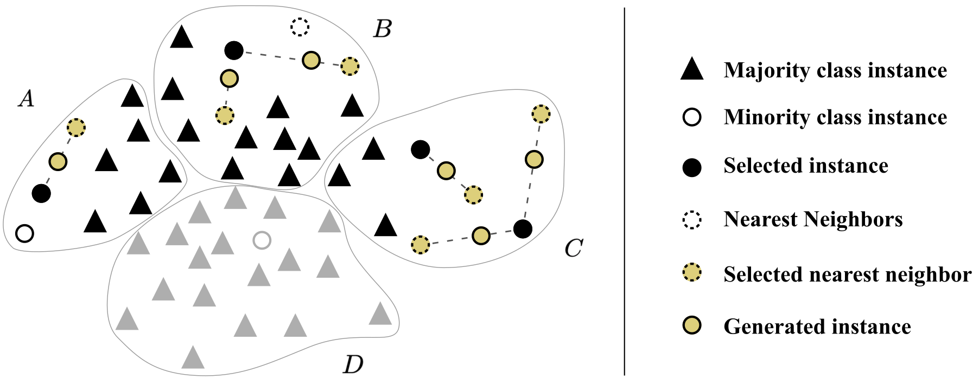
Improving Imbalanced Land Cover Classification with K-means SMOTE: Detecting and Oversampling Distinctive Minority Spectral Signatures
1
Example of K-means SMOTE’s data generation process.
PhD Examination – October 12th, 2023
João Fonseca

Slide 30
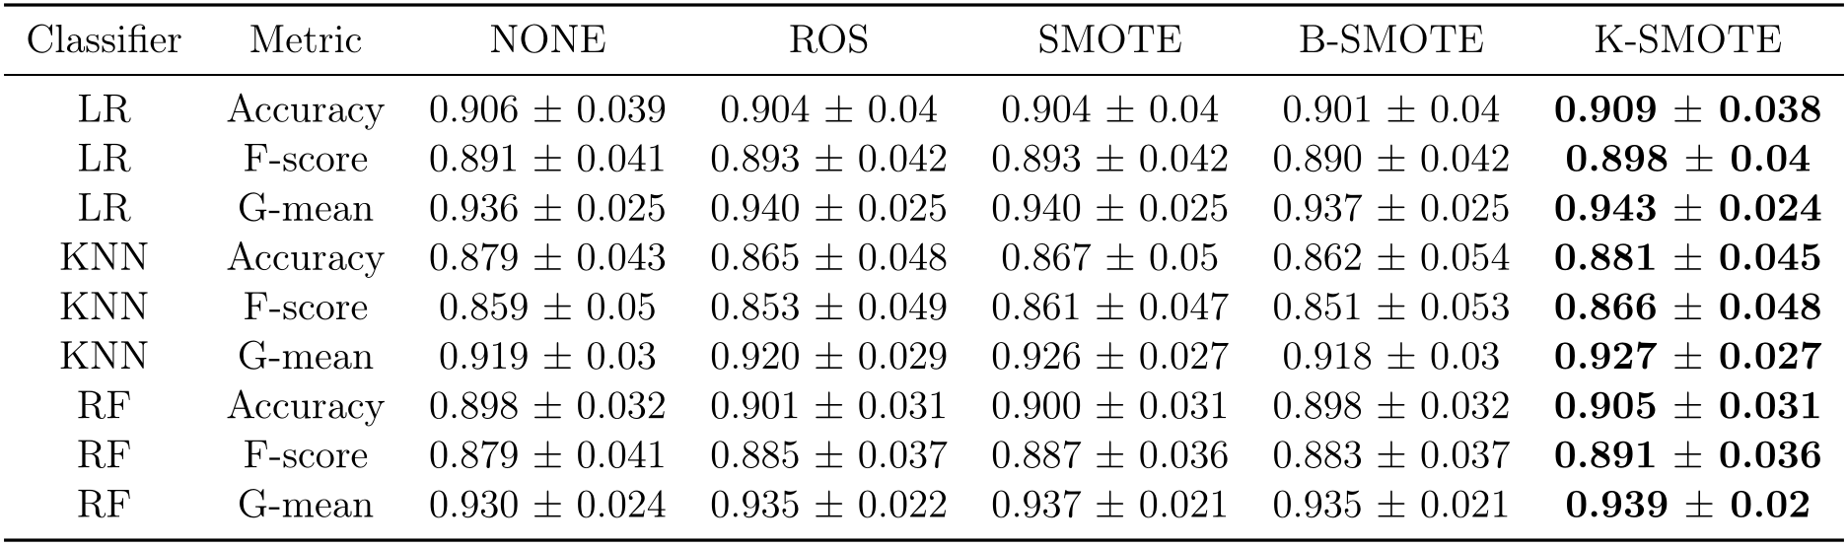
Improving Imbalanced Land Cover Classification with K-means SMOTE: Detecting and Oversampling Distinctive Minority Spectral Signatures
1
Mean cross-validation scores of oversamplers.
PhD Examination – October 12th, 2023
João Fonseca

Slide 31
Improving Imbalanced Land Cover Classification with K-means SMOTE: Detecting and Oversampling Distinctive Minority Spectral Signatures
1
Conclusions:
A distinctive characteristic of LULC classification is the potential for some classes to contain significantly different spectral signatures (e.g., forests composed majorly by pine trees vs spruce trees)
Clustering-based synthetic data generation assists in distinguishing these differences within a minority class among clusters and avoid the generation of noisy synthetic data
To do this, we introduced K-means SMOTE in LULC, which proved to be effective across several LULC classification problems
PhD Examination – October 12th, 2023
João Fonseca

Slide 32
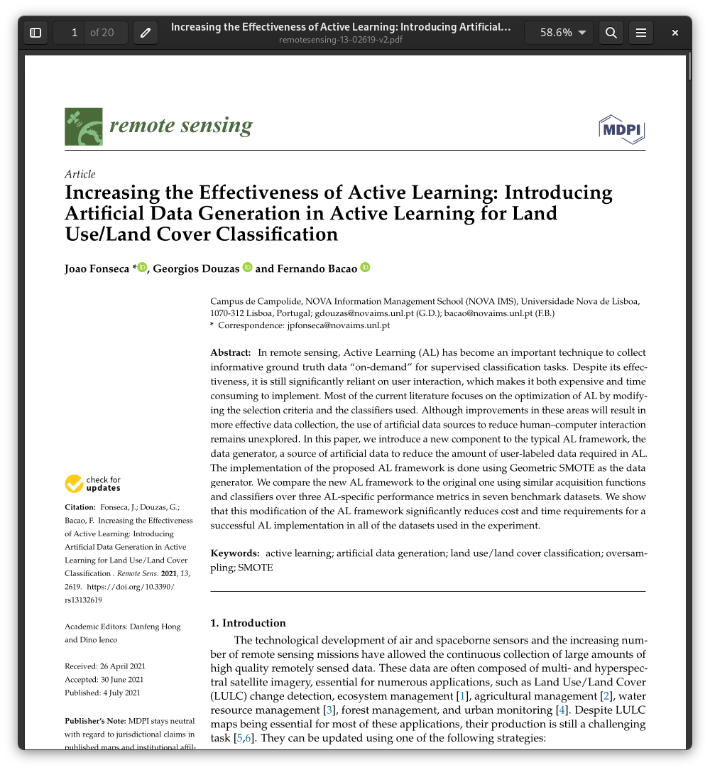
Increasing the Effectiveness of Active Learning: Introducing Artificial Data Generation in Active Learning for Land Use/Land Cover Classification
1
Published as:
Fonseca, J., Douzas, G., Bacao, F. (2021). Increasing the Effectiveness of Active Learning: Introducing Artificial Data Generation in Active Learning for Land Use/Land Cover Classification. Remote Sensing, 13(13), 2619.
PhD Examination – October 12th, 2023
João Fonseca

Slide 33
Increasing the Effectiveness of Active Learning: Introducing Artificial Data Generation in Active Learning for Land Use/Land Cover Classification
1
In remote sensing, Active Learning (AL) has become an important technique to collect informative ground truth data.
It relies on user interaction, making it expensive and time consuming.
Most of the current literature attempt to optimize AL by modifying the selection criteria and the classifiers used.
In this paper, we introduce a new component to the typical AL framework, the data generator.
PhD Examination – October 12th, 2023
João Fonseca

Slide 34
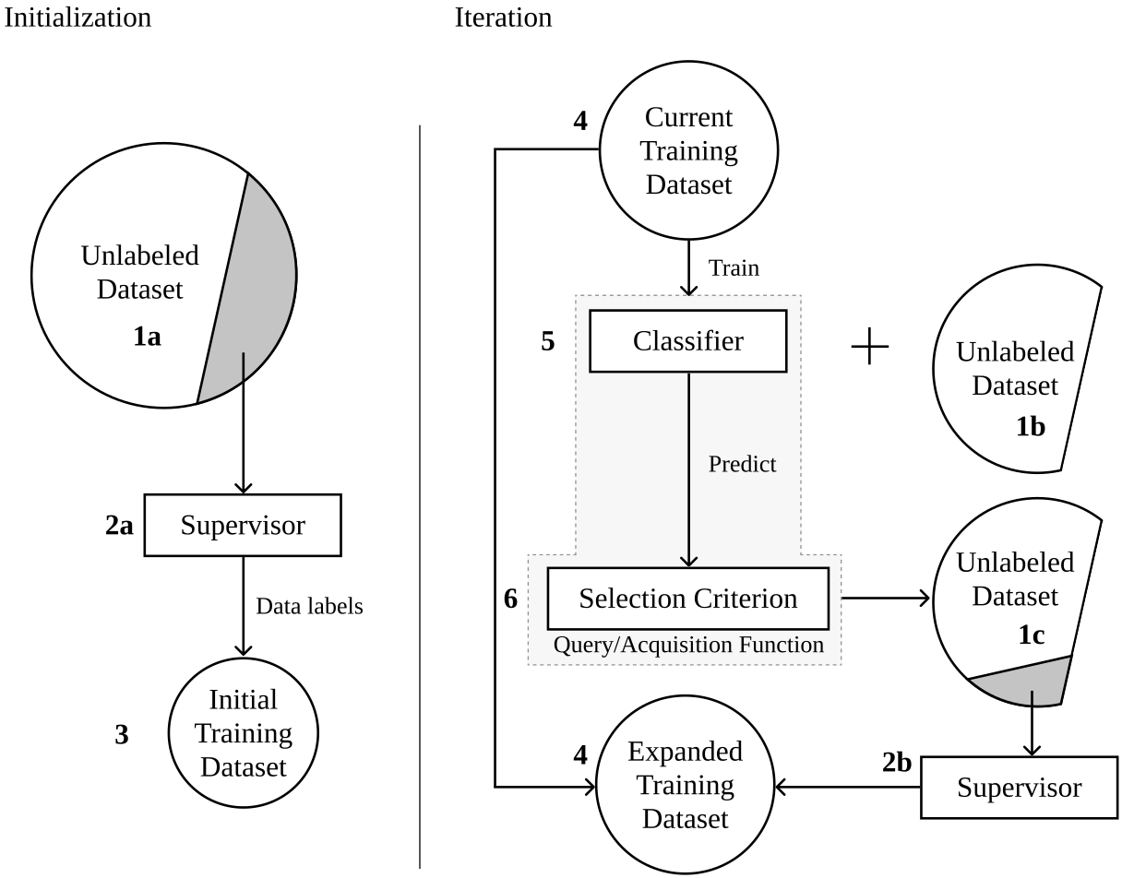
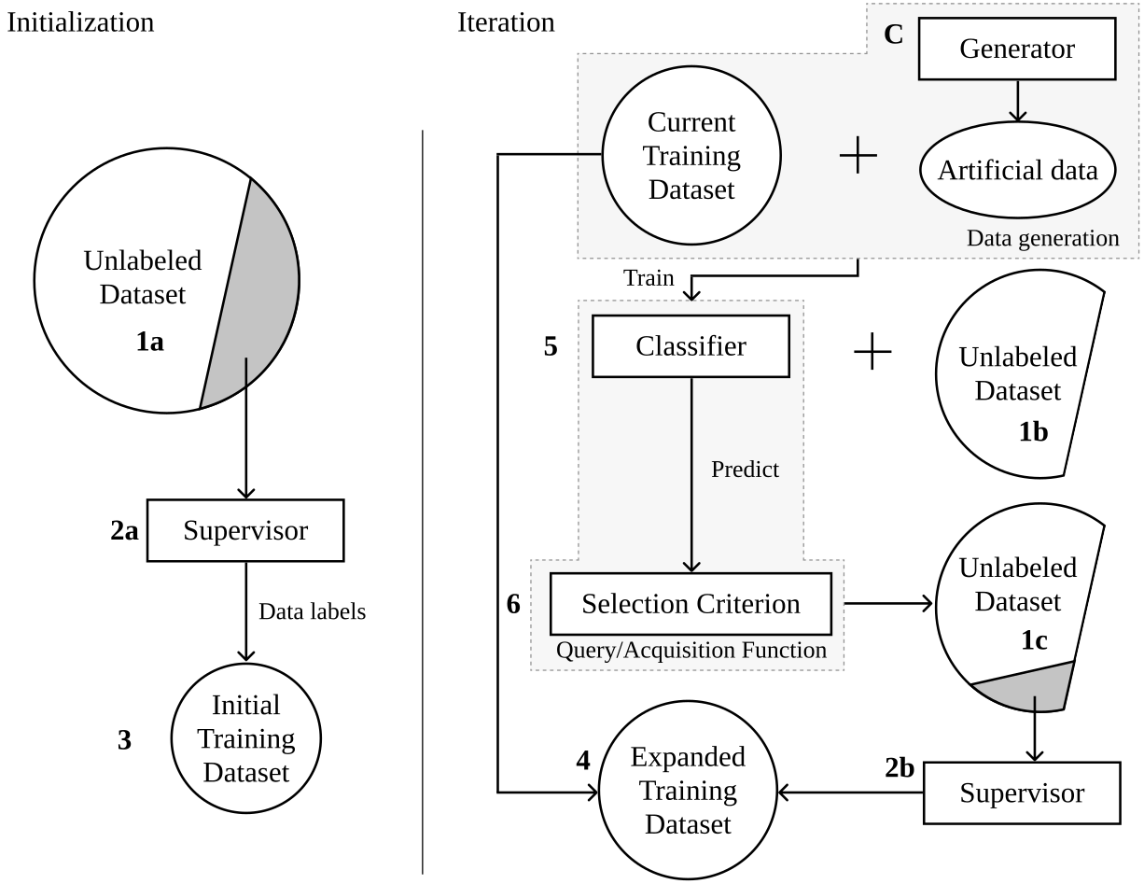
Increasing the Effectiveness of Active Learning: Introducing Artificial Data Generation in Active Learning for Land Use/Land Cover Classification
1
Typical AL framework
Proposed method
PhD Examination – October 12th, 2023
João Fonseca

Slide 35
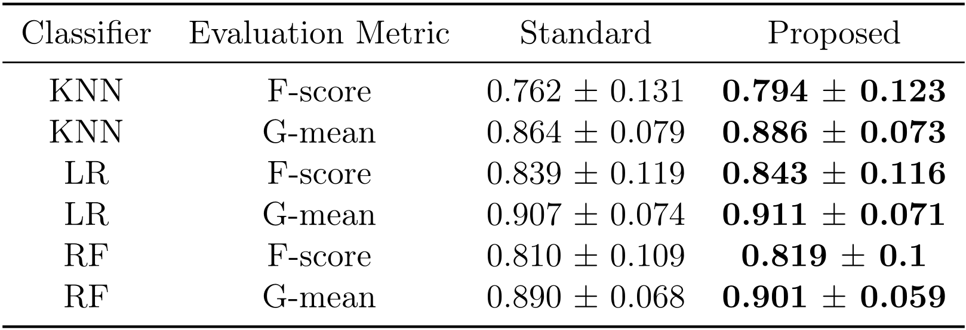
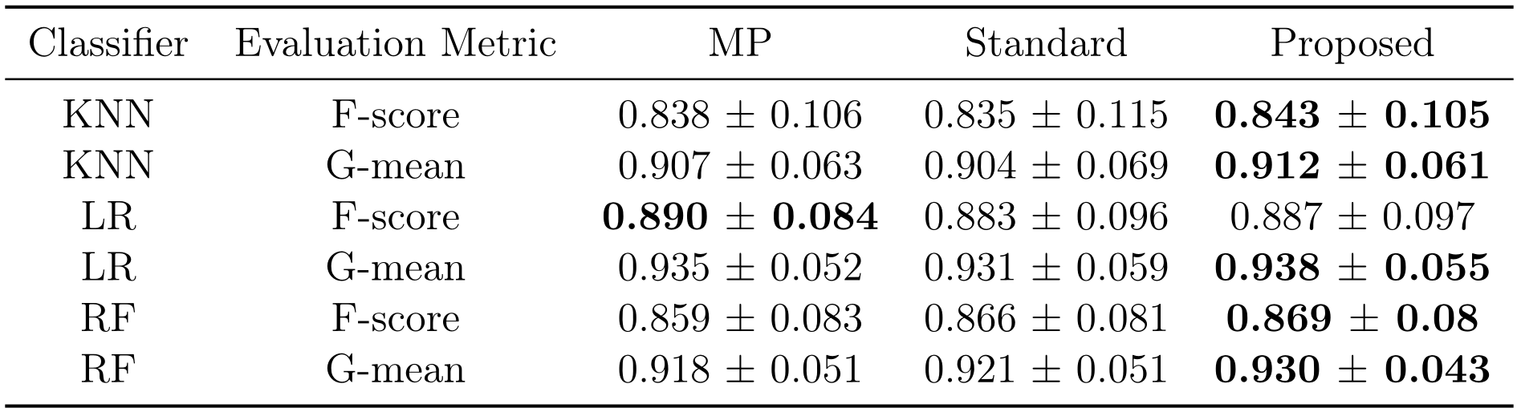
Increasing the Effectiveness of Active Learning: Introducing Artificial Data Generation in Active Learning for Land Use/Land Cover Classification
1
Average AULC of each AL configuration tested.
Optimal classification scores.
PhD Examination – October 12th, 2023
João Fonseca
Notes:
EXPLAIN AULC

Slide 36
Increasing the Effectiveness of Active Learning: Introducing Artificial Data Generation in Active Learning for Land Use/Land Cover Classification
1
Conclusions:
The proposed AL framework was one of the first methods to implement synthetic data into AL with tabular data
The proposed framework showed a significant reduction of the amount of labeled data required to reach any desired level of performance
This method may be used to reduce the labeling cost when preparing a training dataset without affecting classification performance
PhD Examination – October 12th, 2023
João Fonseca

Slide 37
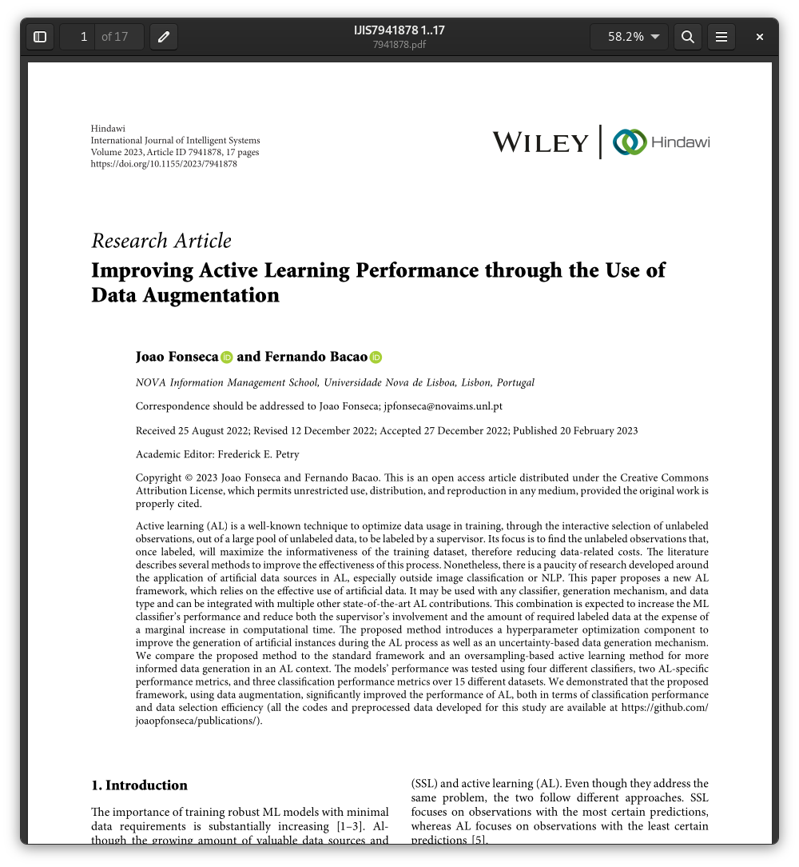
Improving Active Learning Performance Through the Use of Data Augmentation
1
Published as:
Fonseca, J., & Bacao, F. (2023). Improving Active Learning Performance through the Use of Data Augmentation. International Journal of Intelligent Systems, 2023.
PhD Examination – October 12th, 2023
João Fonseca

Slide 38
Improving Active Learning Performance Through the Use of Data Augmentation
1
There is a paucity of research developed around the application of artificial data sources in AL, especially outside image classification or NLP.
We propose an improved AL framework, which relies on the effective use of artificial data.
It may be used with any classifier, generation mechanism and data type, and can be integrated with multiple other state-of-the-art AL contributions.
The proposed method introduces a hyperparameter optimization component to improve the generation of artificial instances during the AL process, as well as an uncertainty-based data generation mechanism.
PhD Examination – October 12th, 2023
João Fonseca

Slide 39
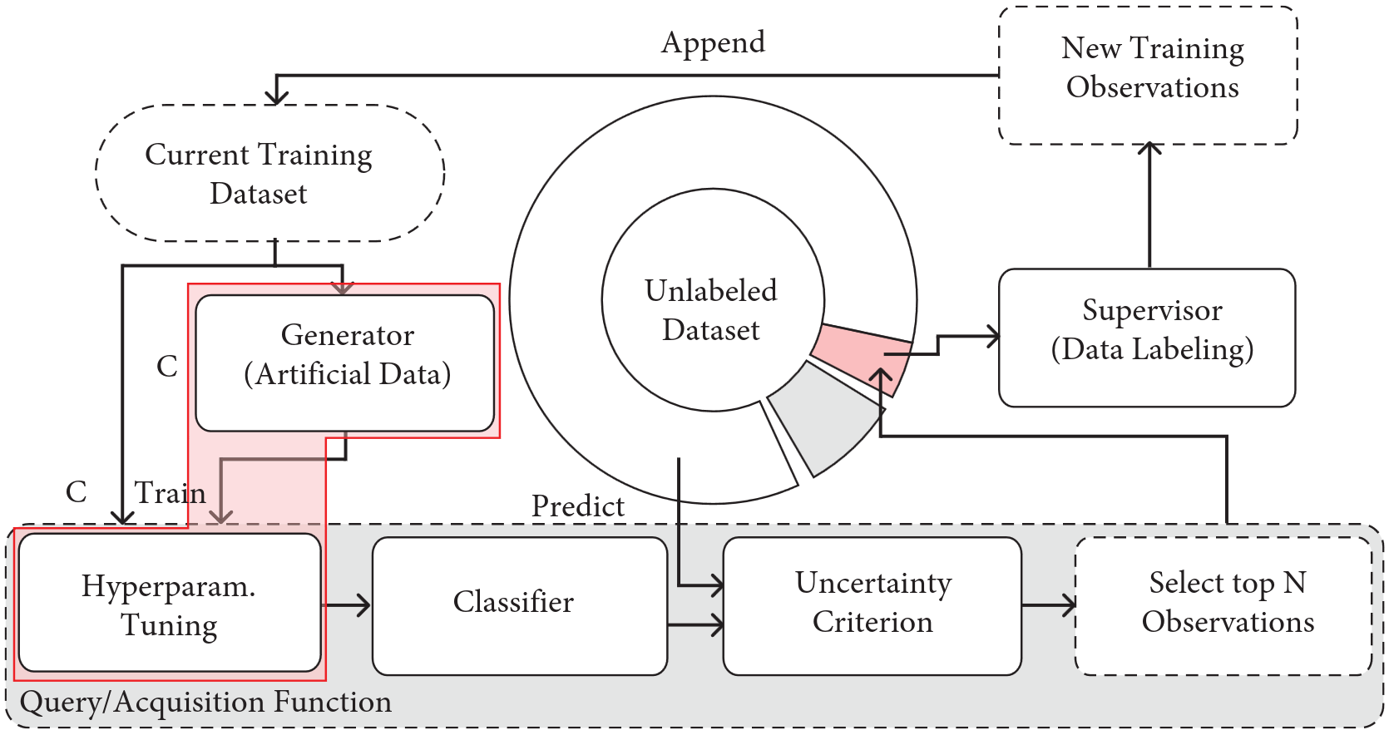
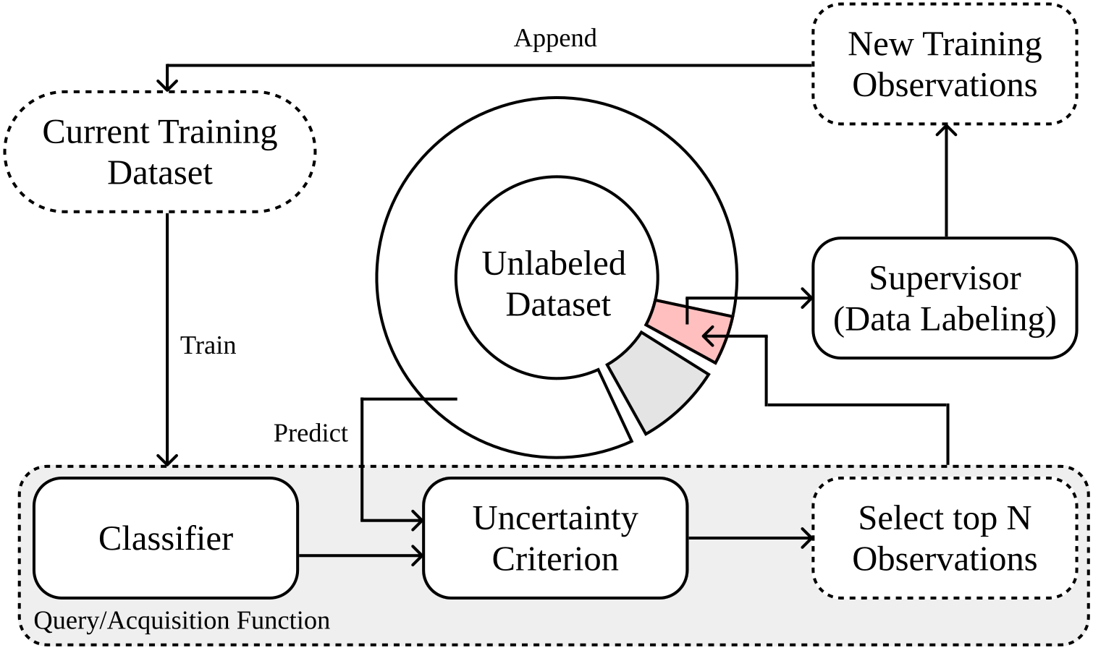
Improving Active Learning Performance Through the Use of Data Augmentation
1
Diagram depicting an AL iteration.
Diagram depicting the proposed AL iteration. The proposed modifications are comprised within the red polygon and marked with a boldface “C.”
PhD Examination – October 12th, 2023
João Fonseca

Slide 40
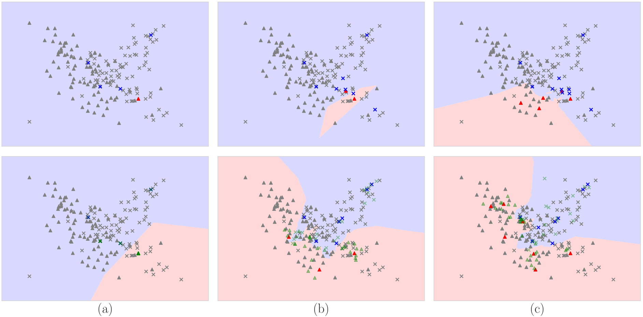
Improving Active Learning Performance Through the Use of Data Augmentation
1
Original
Proposed
Illustration of the different acquisition processes in AL (rows) using a K-Nearest Neighbors classifier and Shannon’s entropy as the uncertainty estimation function, with five observations being collected and labeled per iteration (columns).
PhD Examination – October 12th, 2023
João Fonseca
Notes:
EXPLAIN BETTER

Slide 41
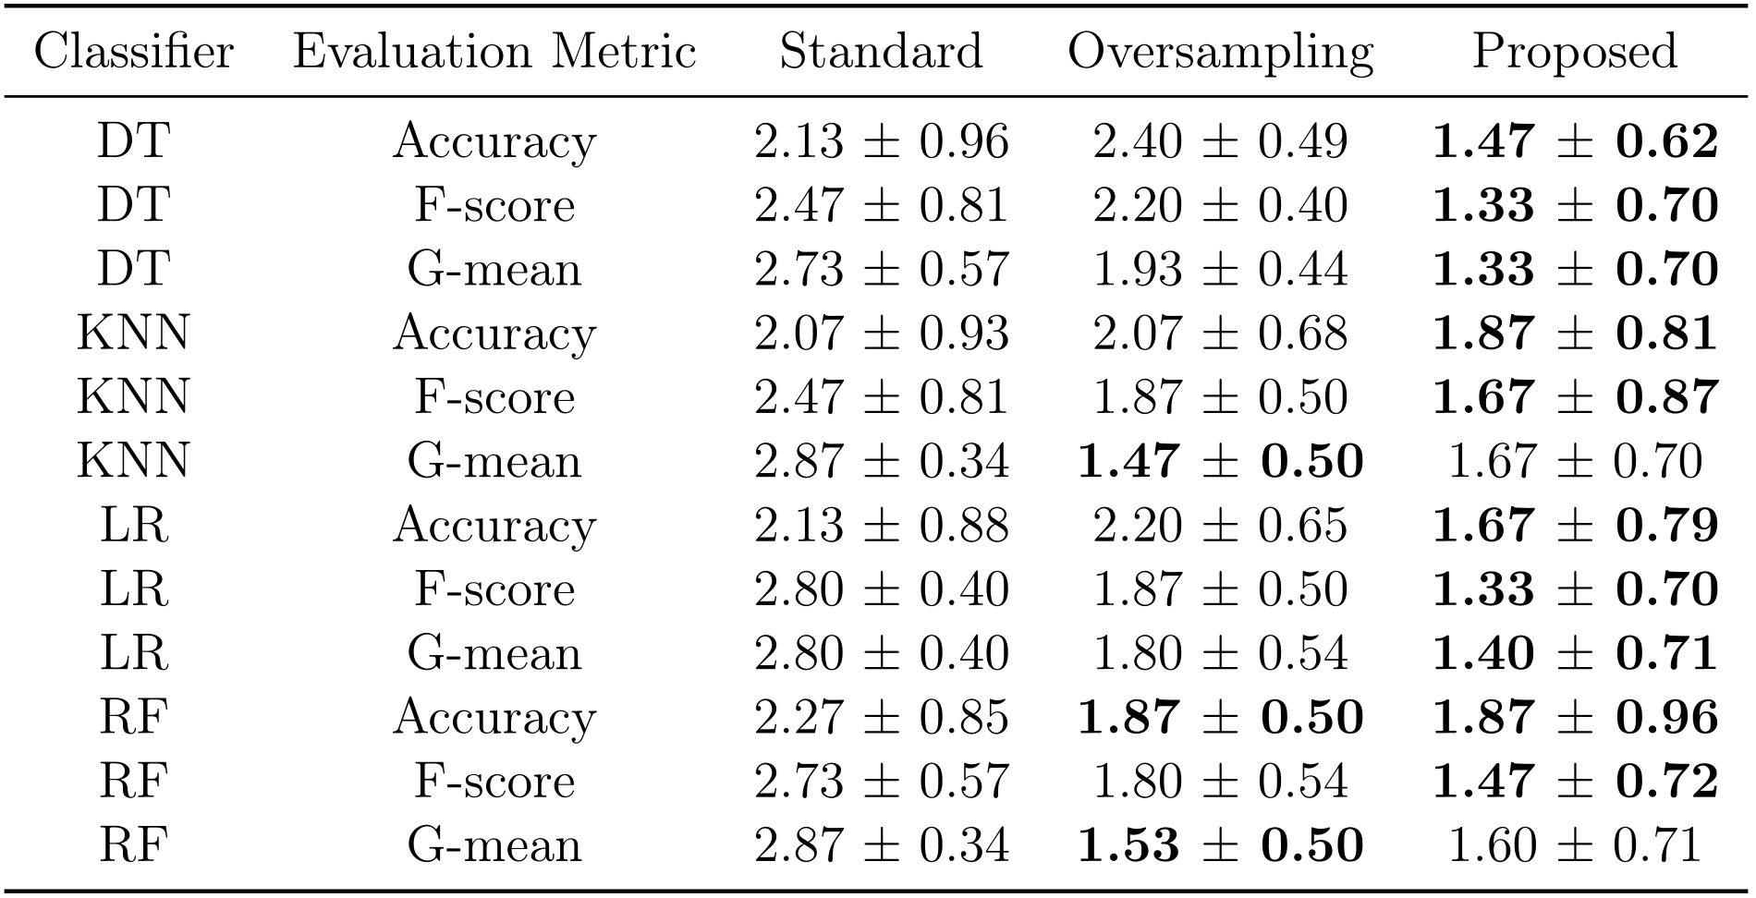
Improving Active Learning Performance Through the Use of Data Augmentation
1
Mean rankings of the AULC metric over the different datasets (15), folds (5), and runs (3) used in the experiment.
PhD Examination – October 12th, 2023
João Fonseca

Slide 42
Improving Active Learning Performance Through the Use of Data Augmentation
1
Conclusions:
The proposed method consists of a generalization of the AL framework previously proposed regarding the domain of application and data generation policy
The proposed AL framework further reduced the amount of data labeling required to achieve a comparable classification performance
The performance of the resulting classifiers also outperformed the ones trained on the entire dataset
PhD Examination – October 12th, 2023
João Fonseca

Slide 43
Closing remarks
1
The main focus of these questions was to address common scenarios where typical ML techniques will not work as intended:
Imbalanced learning
Supervised learning with scarcity of labeled data
The main contributions of this dissertation can be summarized as follows:
Address the limitation of oversampling on datasets with mixed data types
Improvement of AL frameworks using on synthetic data
Improvement of imbalanced LULC classification via oversampling
PhD Examination – October 12th, 2023
João Fonseca

Slide 44
Current and future work
1
Selected recent working papers (not part of the PhD Thesis):
Bell, A.*, Fonseca, J.*, Abrate, C., Bonchi, F., Stoyanovich, J. (2023). Fairness in Algorithmic Recourse Through the Lens of Substantive Equality of Opportunity. Working paper.
Fonseca, J. (2023). A General Purpose Synthetic Data Generation Ensemble Mechanism for Fully, Semi and Self-Supervised Learning. Working paper.
Pliatsika, V., Fonseca, J., Wang, T., Stoyanovich, J. (2023). ShaRP: Explaining Rankings with Shapley Values. Under submission.
Fonseca, J.*, Bell, A.*, Abrate, C., Bonchi, F., Stoyanovich, J. (2023). Setting the Right Expectations: Algorithmic Recourse Over Time. Accepted for the third ACM conference on Equity and Access in Algorithms, Mechanisms, and Optimization (EAAMO’23).
* – Equal contribution
PhD Examination – October 12th, 2023
João Fonseca

Slide 45
Thank you!
Questions?
NOVA Information Management School
Doctoral Program in Information Management
October 12th, 2023

Slide 46
Appendix
Quick access links:
Chapter 1 - Introduction
Chapter 2 - Literature Review
Chapter 3 - G-SMOTENC
Chapter 4 - K-means SMOTE (LULC)
Chapter 5 - Active Learning (LULC)
Chapter 6 - Active Learning (Synth. Data)
NOVA Information Management School
Doctoral Program in Information Management
October 12th, 2023

Slide 47
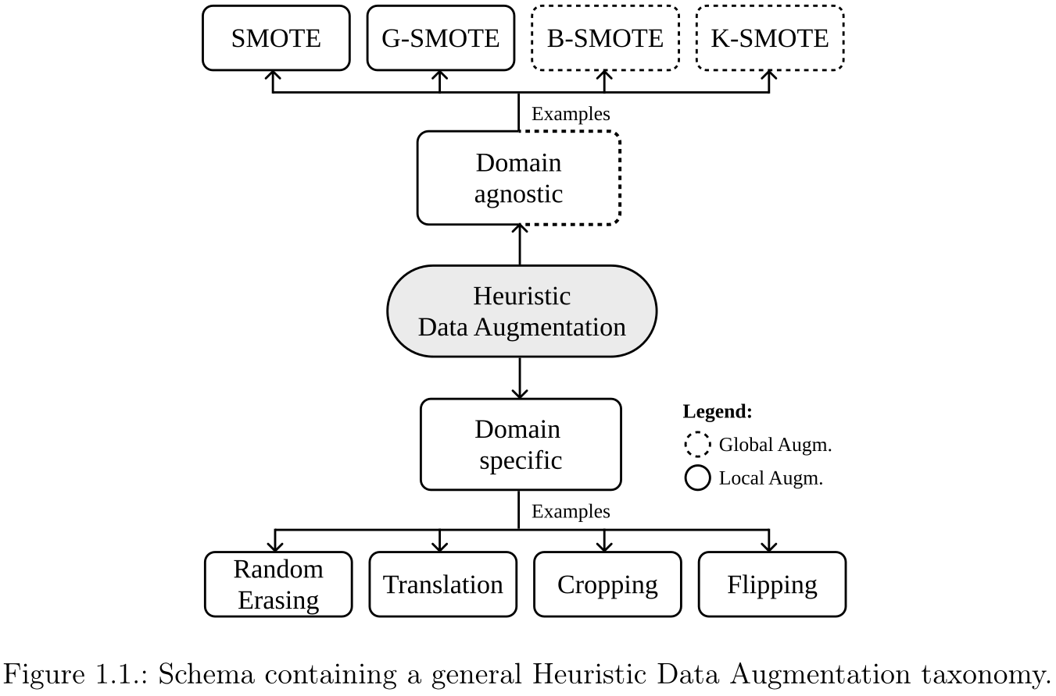
Chapter 1 – Introduction
Back
46
PhD Examination – October 12th, 2023
João Fonseca

Slide 48
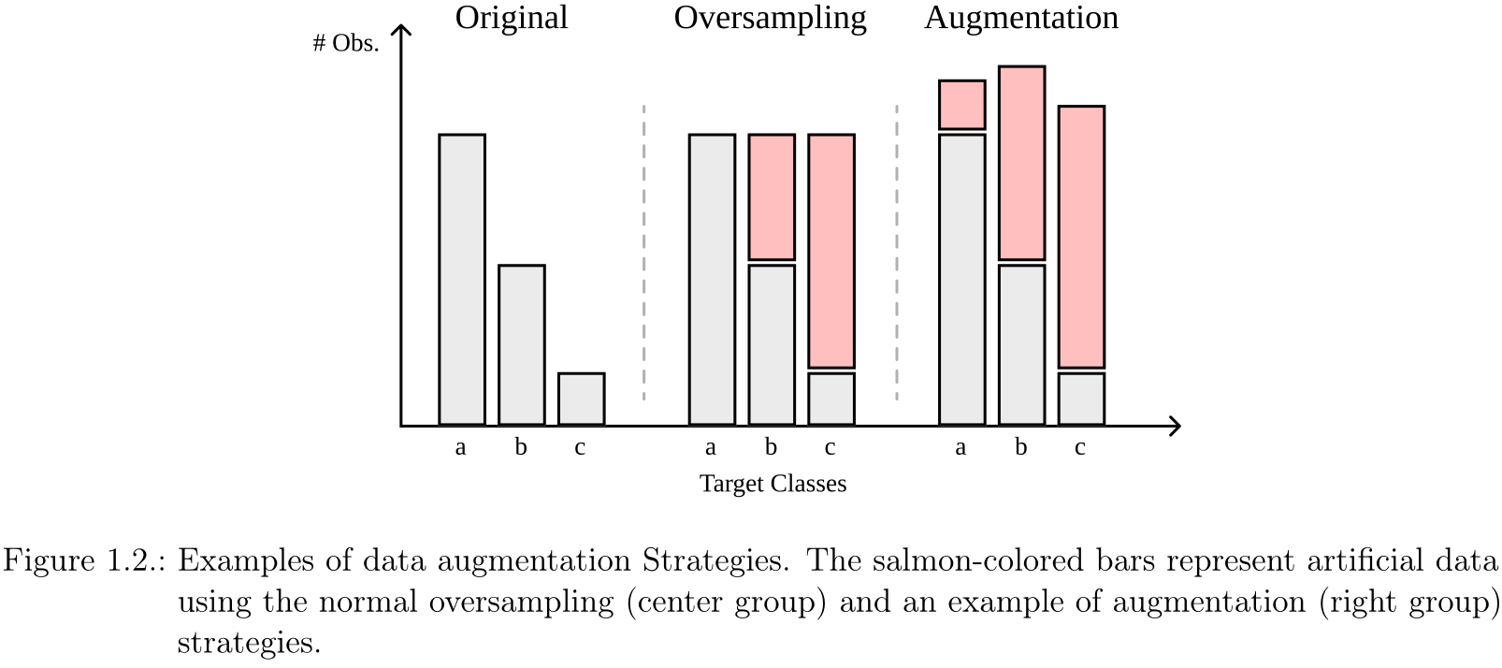
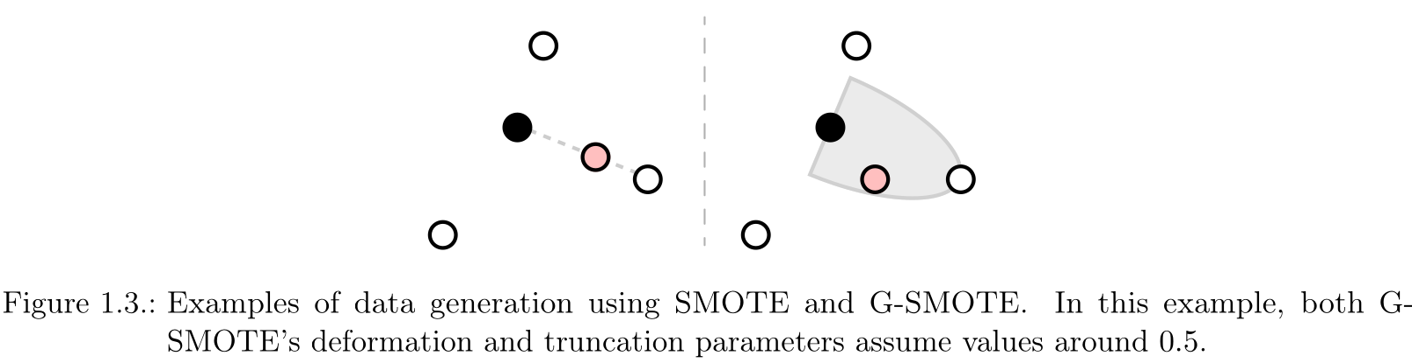
Chapter 1 – Introduction
Back
46
PhD Examination – October 12th, 2023
João Fonseca

Slide 49
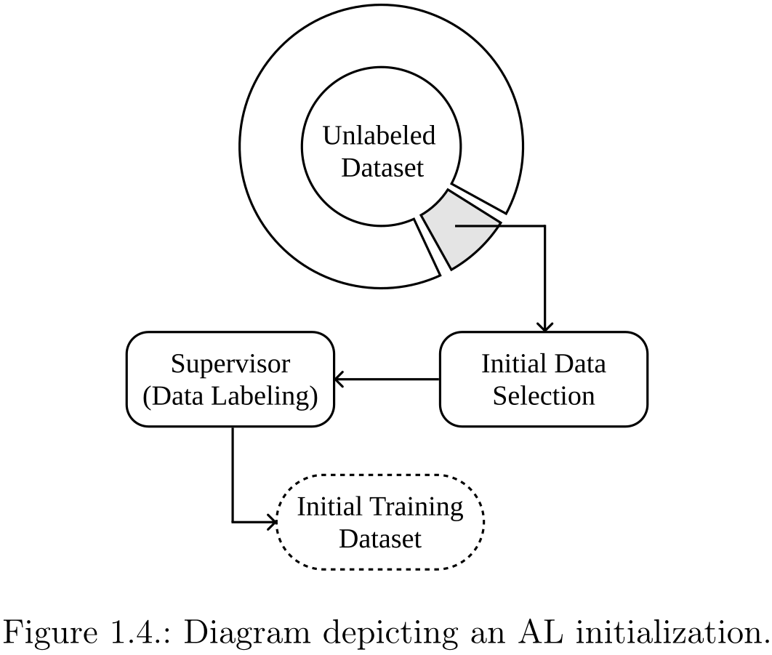
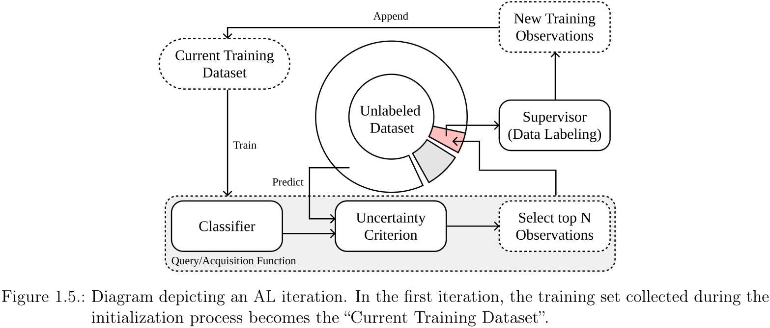
Chapter 1 – Introduction
Back
46
PhD Examination – October 12th, 2023
João Fonseca

Slide 50
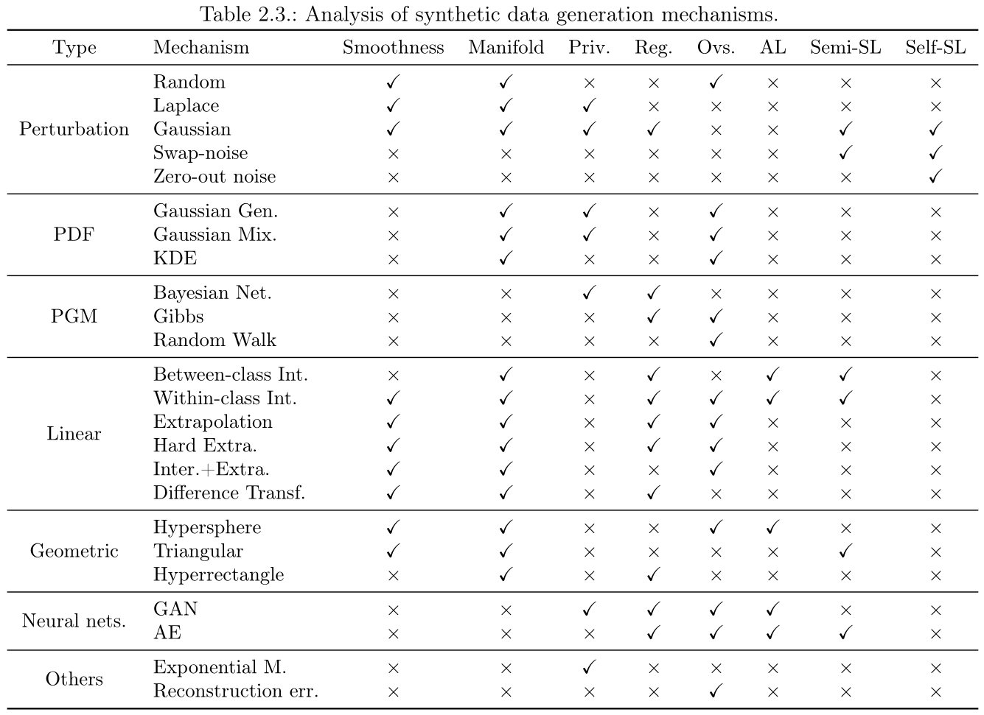
Chapter 2 – Literature review
Back
46
PhD Examination – October 12th, 2023
João Fonseca

Slide 51
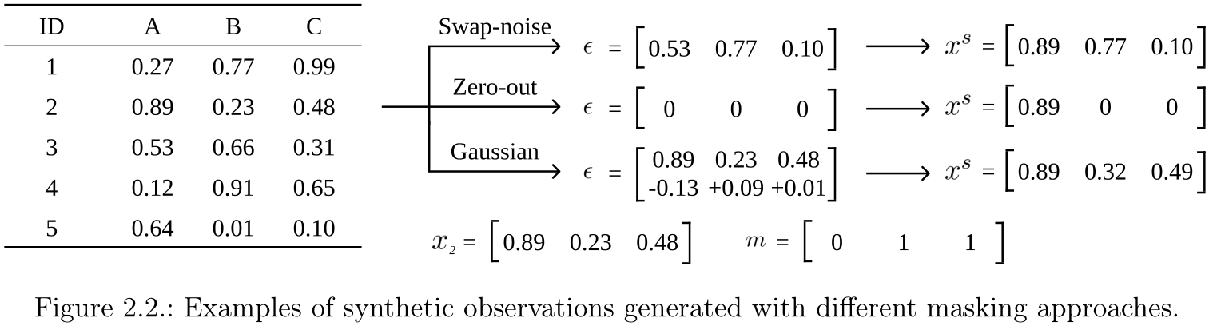
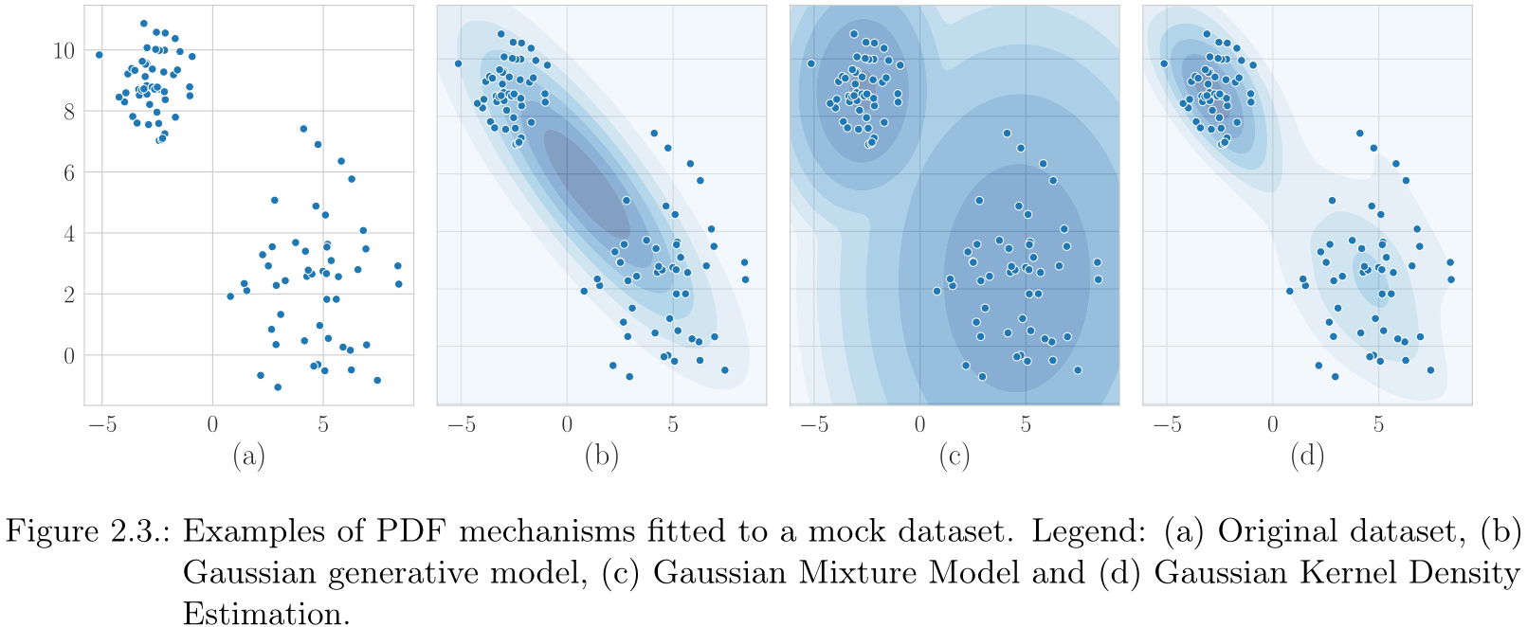
Chapter 2 – Literature review
Back
46
PhD Examination – October 12th, 2023
João Fonseca

Slide 52
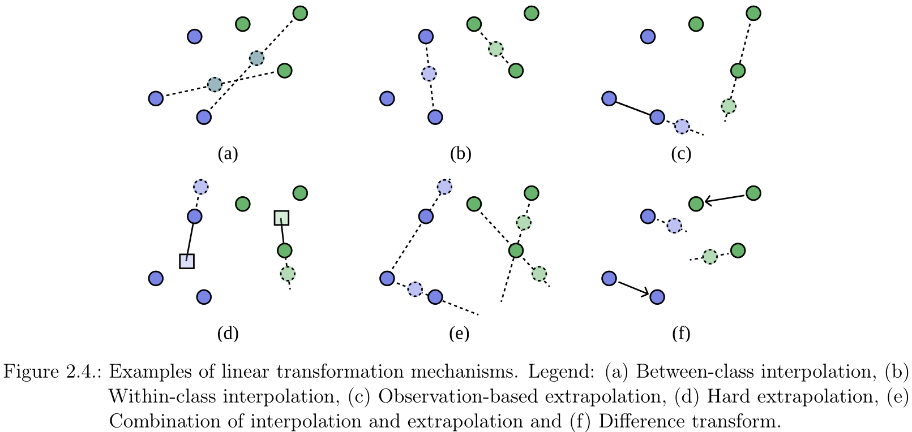
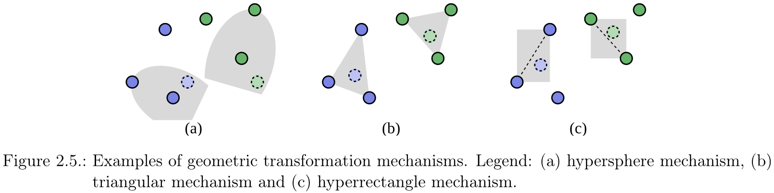
Chapter 2 – Literature review
Back
46
PhD Examination – October 12th, 2023
João Fonseca

Slide 53
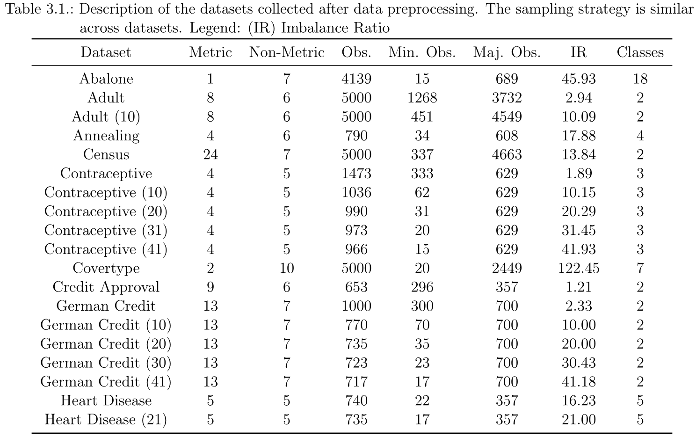
Chapter 3 – G-SMOTENC
Back
46
PhD Examination – October 12th, 2023
João Fonseca

Slide 54
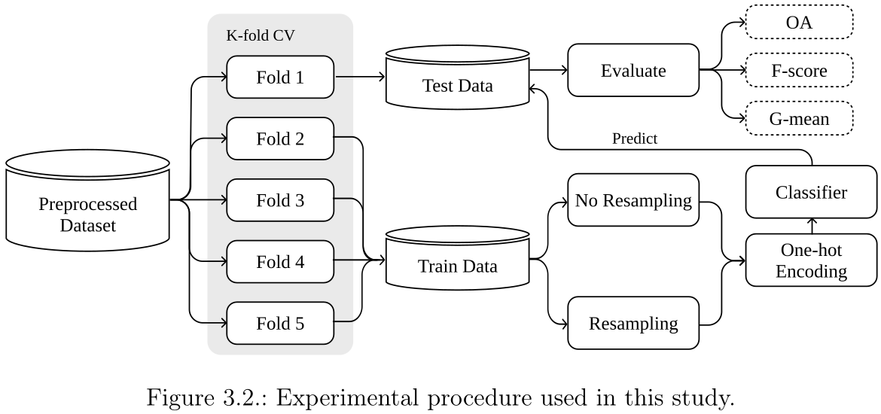
Chapter 3 – G-SMOTENC
Back
46
PhD Examination – October 12th, 2023
João Fonseca

Slide 55
Chapter 3 – G-SMOTENC
Back
46
Mean rankings over the different datasets (20), folds (5) and runs (3) used in the experiment.
PhD Examination – October 12th, 2023
João Fonseca

Slide 56
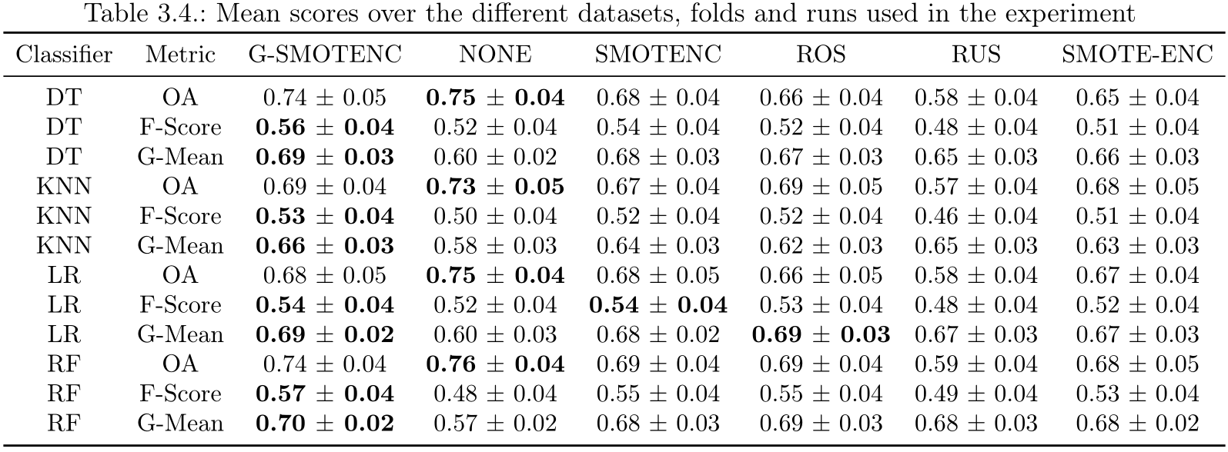
Chapter 3 – G-SMOTENC
Back
46
PhD Examination – October 12th, 2023
João Fonseca

Slide 57
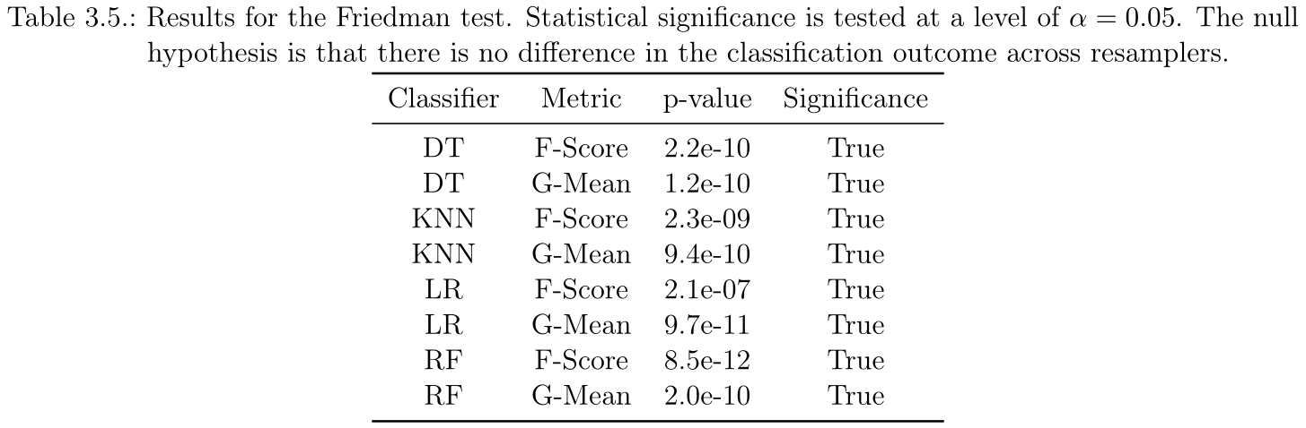
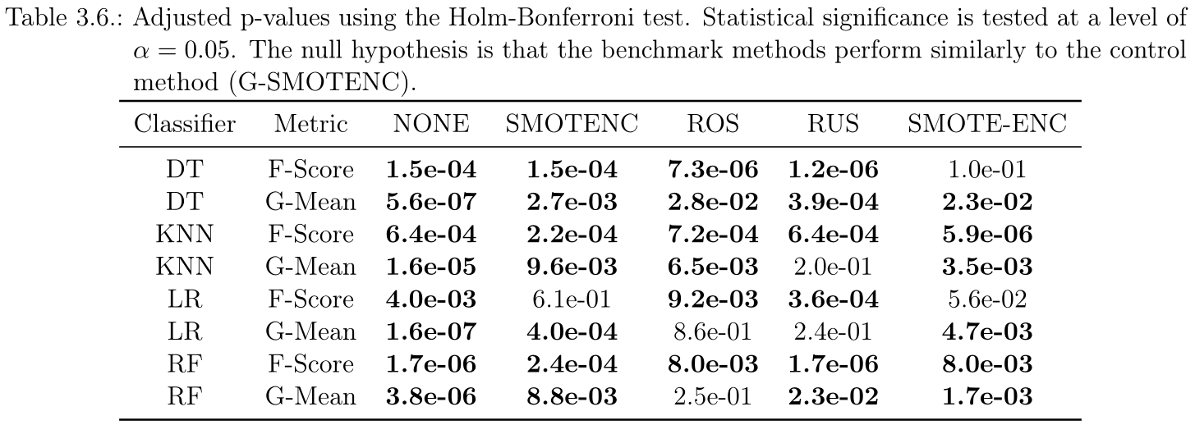
Chapter 3 – G-SMOTENC
Back
46
PhD Examination – October 12th, 2023
João Fonseca

Slide 58
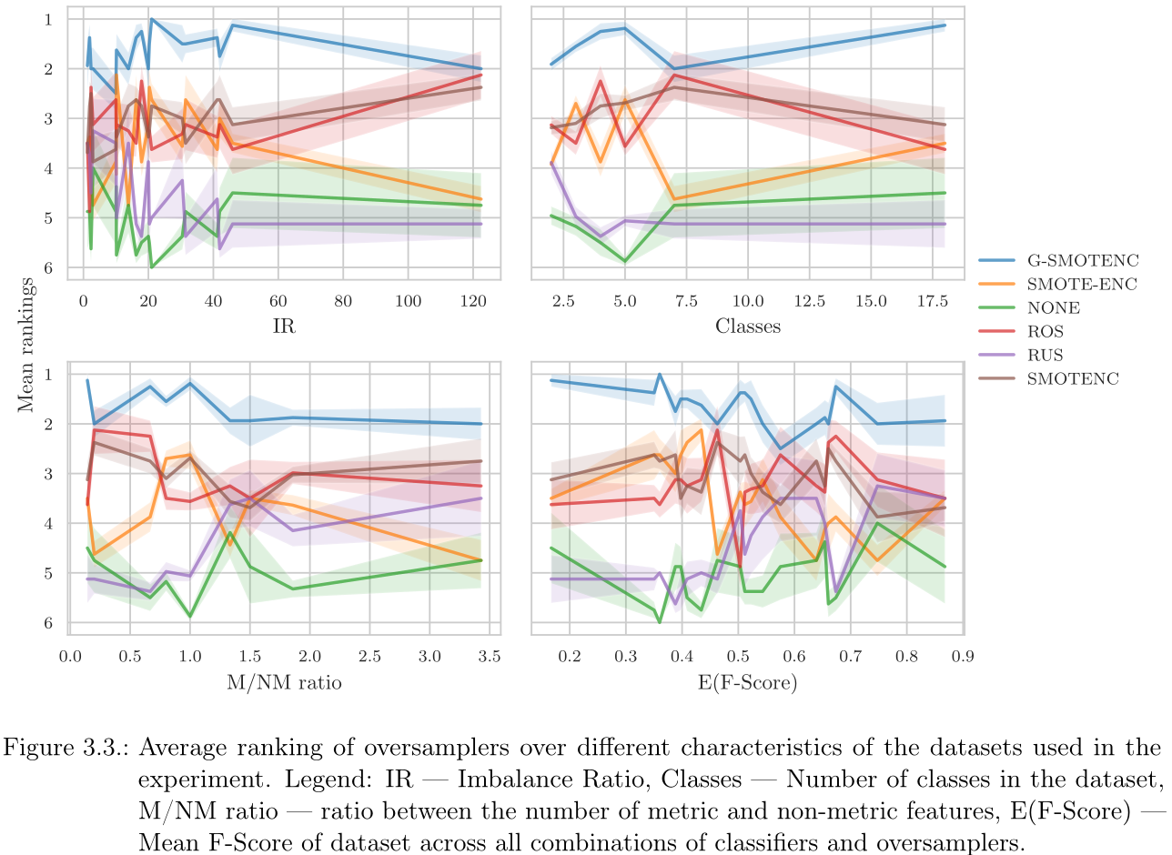
Chapter 3 – G-SMOTENC
Back
46
PhD Examination – October 12th, 2023
João Fonseca

Slide 59
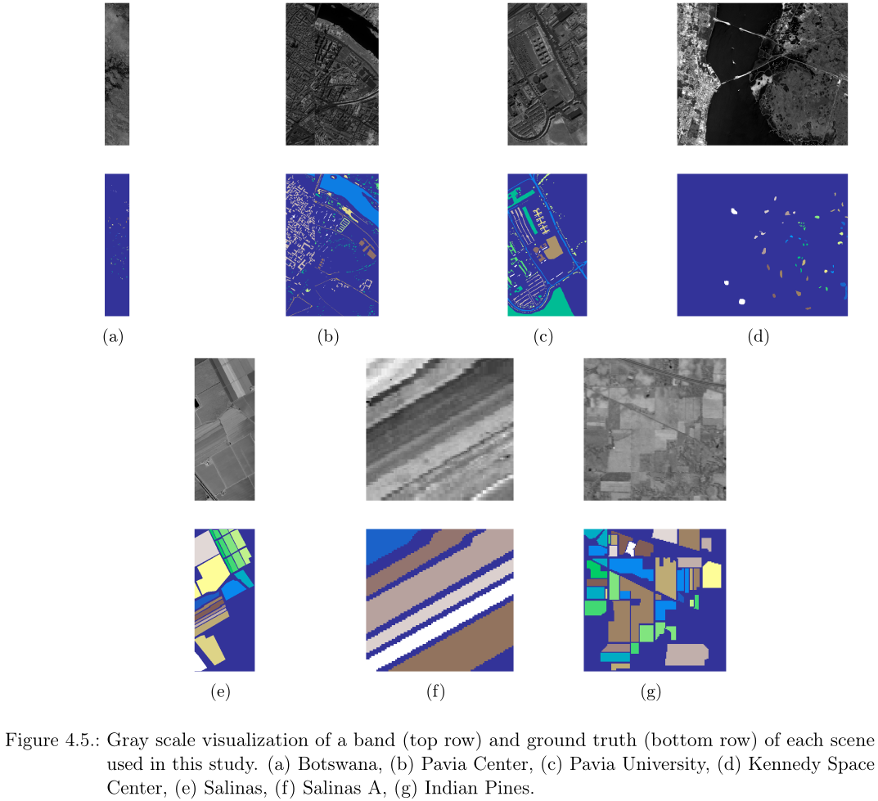
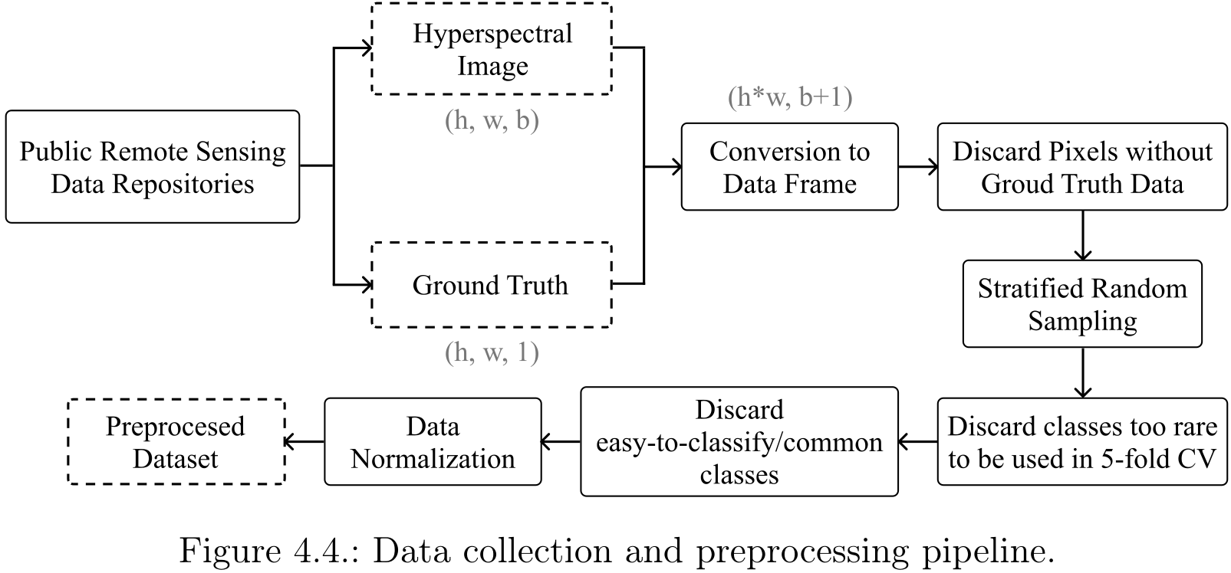
Back
46
Chapter 4 – K-Means SMOTE (LULC)
PhD Examination – October 12th, 2023
João Fonseca

Slide 60
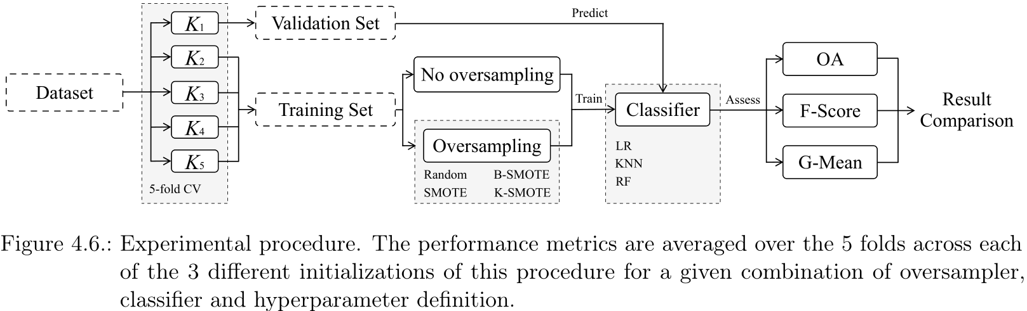
Back
46
Chapter 4 – K-Means SMOTE (LULC)
PhD Examination – October 12th, 2023
João Fonseca

Slide 61
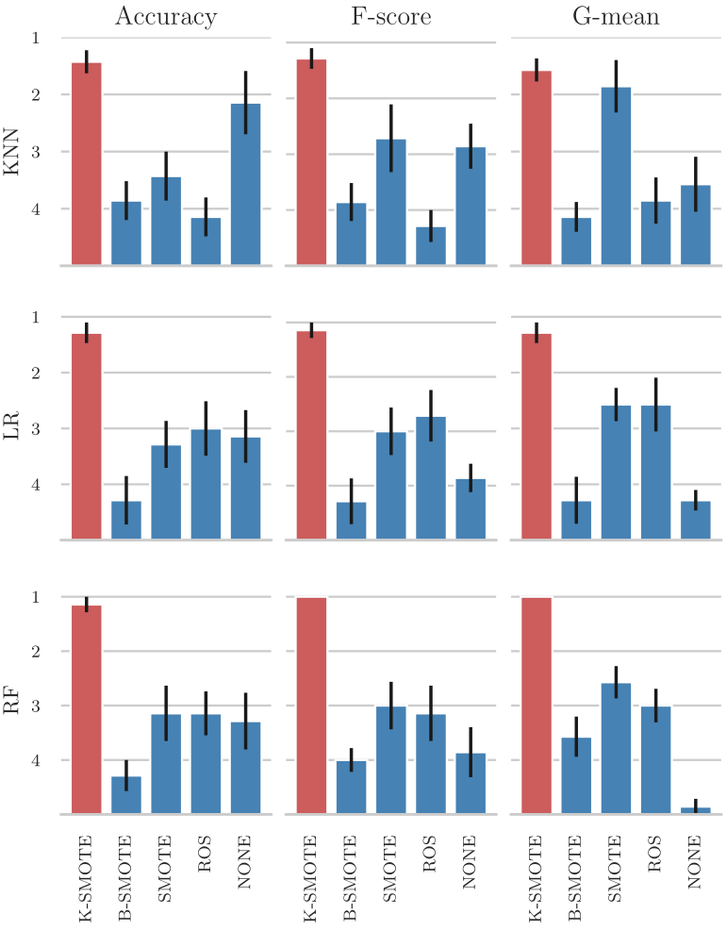
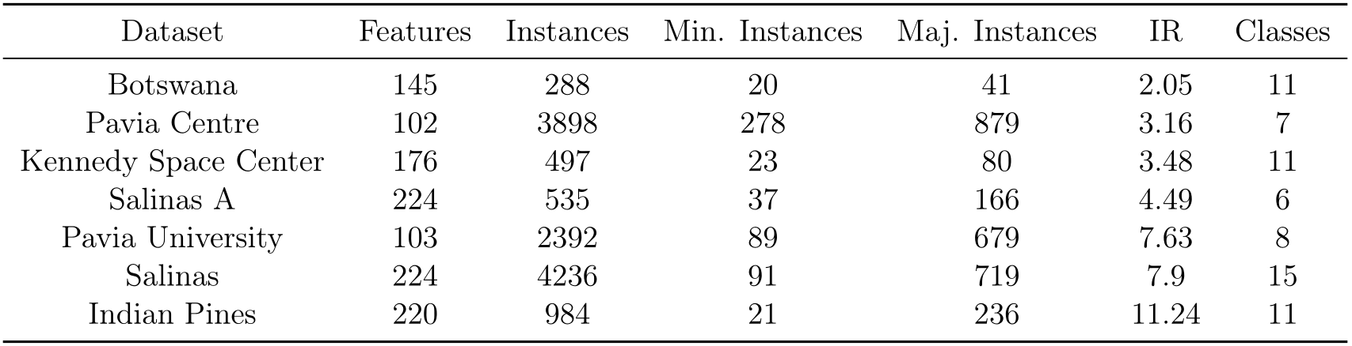
Back
46
Chapter 4 – K-Means SMOTE (LULC)
Description of the datasets used for this experiment
Mean ranking of oversamplers across datasets.
PhD Examination – October 12th, 2023
João Fonseca

Slide 62
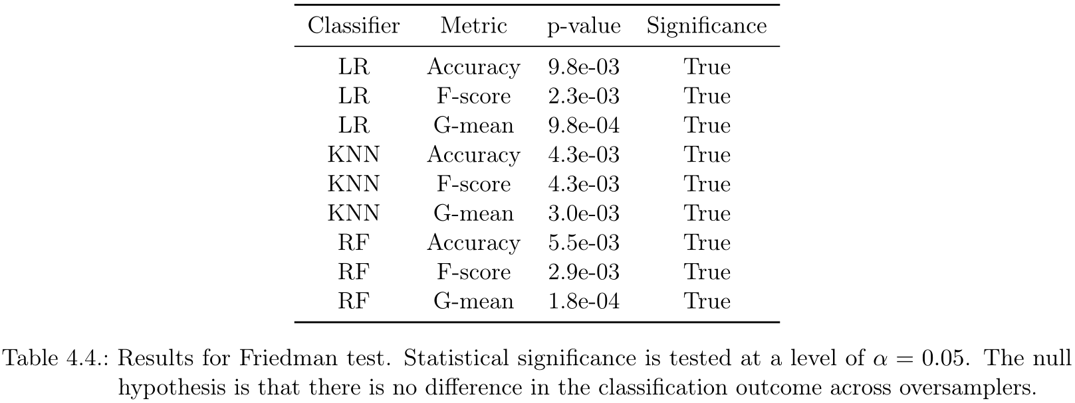
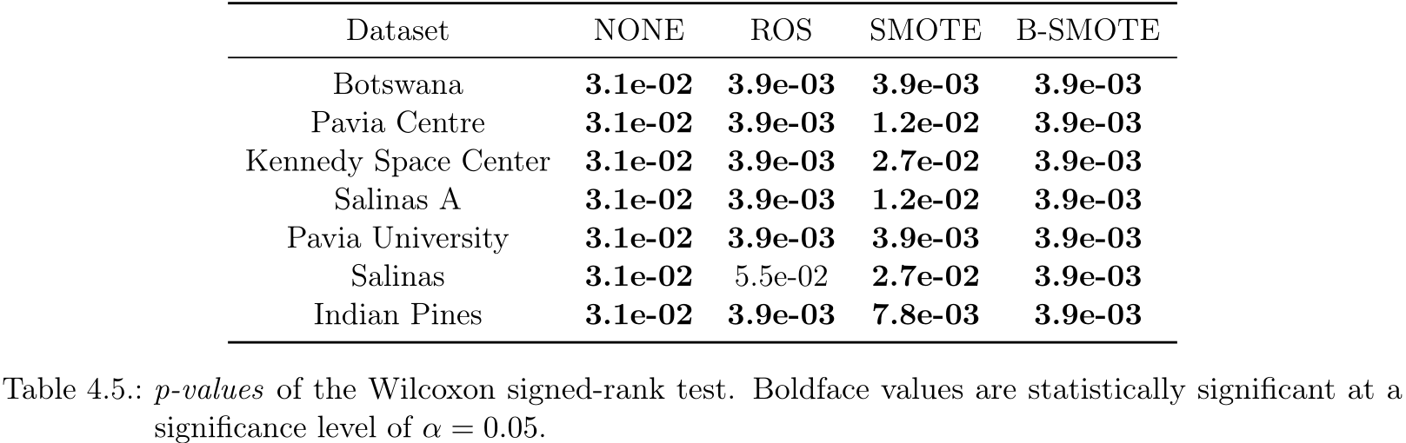
Back
46
Chapter 4 – K-Means SMOTE (LULC)
PhD Examination – October 12th, 2023
João Fonseca

Slide 63
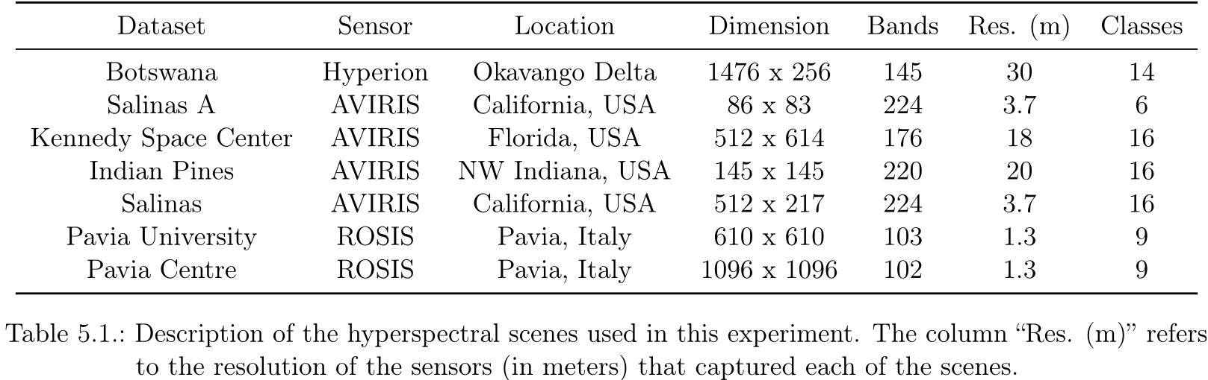
Chapter 5 – Active Learning (LULC)
Back
46
PhD Examination – October 12th, 2023
João Fonseca

Slide 64
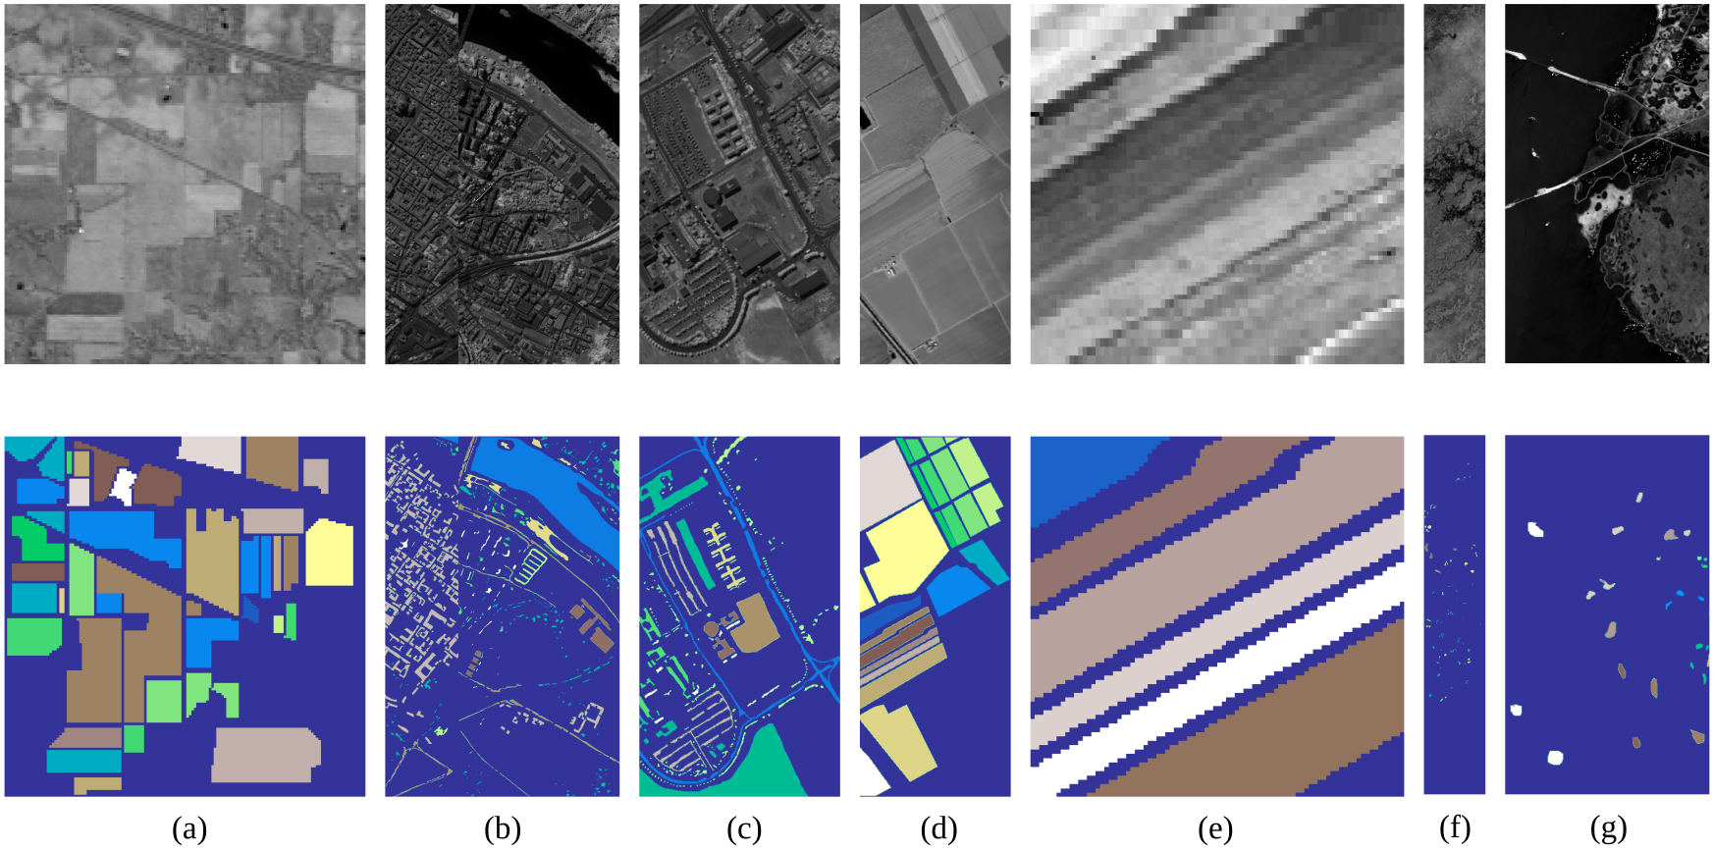

Chapter 5 – Active Learning (LULC)
Back
46
Gray scale visualization of a band and ground truth of each scene used in this study.
Proposed method
Description of the datasets collected from each corresponding scene.
PhD Examination – October 12th, 2023
João Fonseca

Slide 65

Chapter 5 – Active Learning (LULC)
Back
46
PhD Examination – October 12th, 2023
João Fonseca

Slide 66

Chapter 5 – Active Learning (LULC)
Back
46
PhD Examination – October 12th, 2023
João Fonseca

Slide 67

Chapter 6 – Active Learning (Synth. Data)
Back
46
PhD Examination – October 12th, 2023
João Fonseca

Slide 68


Chapter 6 – Active Learning (Synth. Data)
Back
46
PhD Examination – October 12th, 2023
João Fonseca

Slide 69
Chapter 6 – Active Learning (Synth. Data)
Back
46
Mean rankings of the AULC metric over the different datasets (15), folds (5), and runs (3) used in the experiment.
PhD Examination – October 12th, 2023
João Fonseca

Slide 70

Chapter 6 – Active Learning (Synth. Data)
Back
46
PhD Examination – October 12th, 2023
João Fonseca

Slide 71


Chapter 6 – Active Learning (Synth. Data)
Back
46
PhD Examination – October 12th, 2023
João Fonseca

Slide 72

Chapter 6 – Active Learning (Synth. Data)
Back
<number>
PhD Examination – October 12th, 2023
João Fonseca

